Slide 1
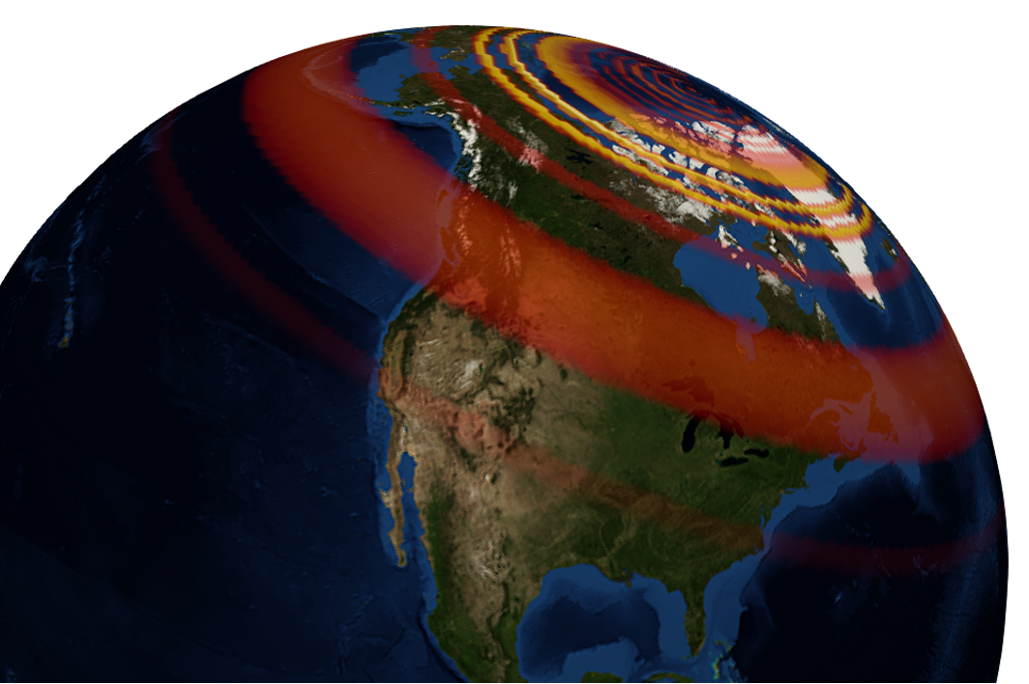
GEOL593: Seismology and Earth Structure, Spring 2023
Lecture 10: Planetary Seismology 1: Seismology on Mars
3/28/23
Ross Maguire
rossrm@illinois.edu
3014 NHB

Slide 2
Class schedule
 | Dates | Topic | Lab assignment
Week 1: | Jan 17, Jan 19 | Course overview | Lab 1: Python crash course
Week 2: | Jan 24, Jan 26 | Seismic signal processing | Lab 2: Introduction to Obspy
Week 3: | Jan 31, Feb 2 | Moment Tensors/ Inverse methods | Lab 3: Moment tensor inversion
Week 4: | Feb 7, Feb 9 | 🤮 No class, Ross ill | Seismic wave propagation 1
Week 5: | Feb 14, Feb 16 | Lab 4: Reference Earth models: The “1D” Earth | Seismic wave propagation 2
Week 6: | Feb 21, Feb 23 | Lab 5: Surface wave dispersion | Surface waves and normal modes
Week 7: | Feb 28, Mar 2 | Lab 6: Normal modes | Imaging Earth Structure 1: Seismic tomography
Week 8: | Mar 7, Mar 9 | Lab 7: Seismic Tomography | Imaging Earth Structure 2: Seismic discontinuities / Research paper discussion
Week 9: |  | Spring break
Week 10: | Mar 21, Mar 23 | Lab 8. Receiver Functions | Anisotropy and anelasticity
Week 11: | Mar 28, Mar 30 | Planetary seismology 1 | Lab 9: InSight- Seismology on Mars
Week 12: | Apr 4, Apr 6 | Planetary seismology 2
Week 13: | Apr 11, Apr 13 | Machine learning in seismology 1 | Lab 10: Earthquake detection
Week 14: | Apr 18, Apr 20 | Machine learning in seismology 2
Week 15: | Apr 25, Apr 27 | Frontiers of seismology: What’s next?
Week 16: | May 2, May 4 | Research paper presentations

Slide 3
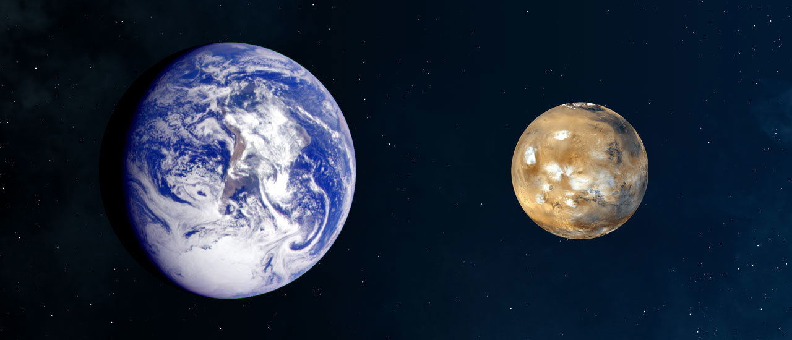
Earth and Mars
 | Earth | Mars
Radius | 6,371 km | 3,389.5 km
Mass | 5.9x10²⁴ kg | 6.4x10²³ kg
Circumference | 40,075 km | 21,344 km
Density | 5.51 g/cm³ | 3.93 g/cm³
Length of day | 23 hrs 56 min | 24 hrs 37 min
Length of year | 365.25 days | 687 Earth days
Avg. temperature | 57 F (13.8 C) | -81 F (-62.7 C)
Atmos. pressure | 1 bar | 0.0065 bar

Slide 4
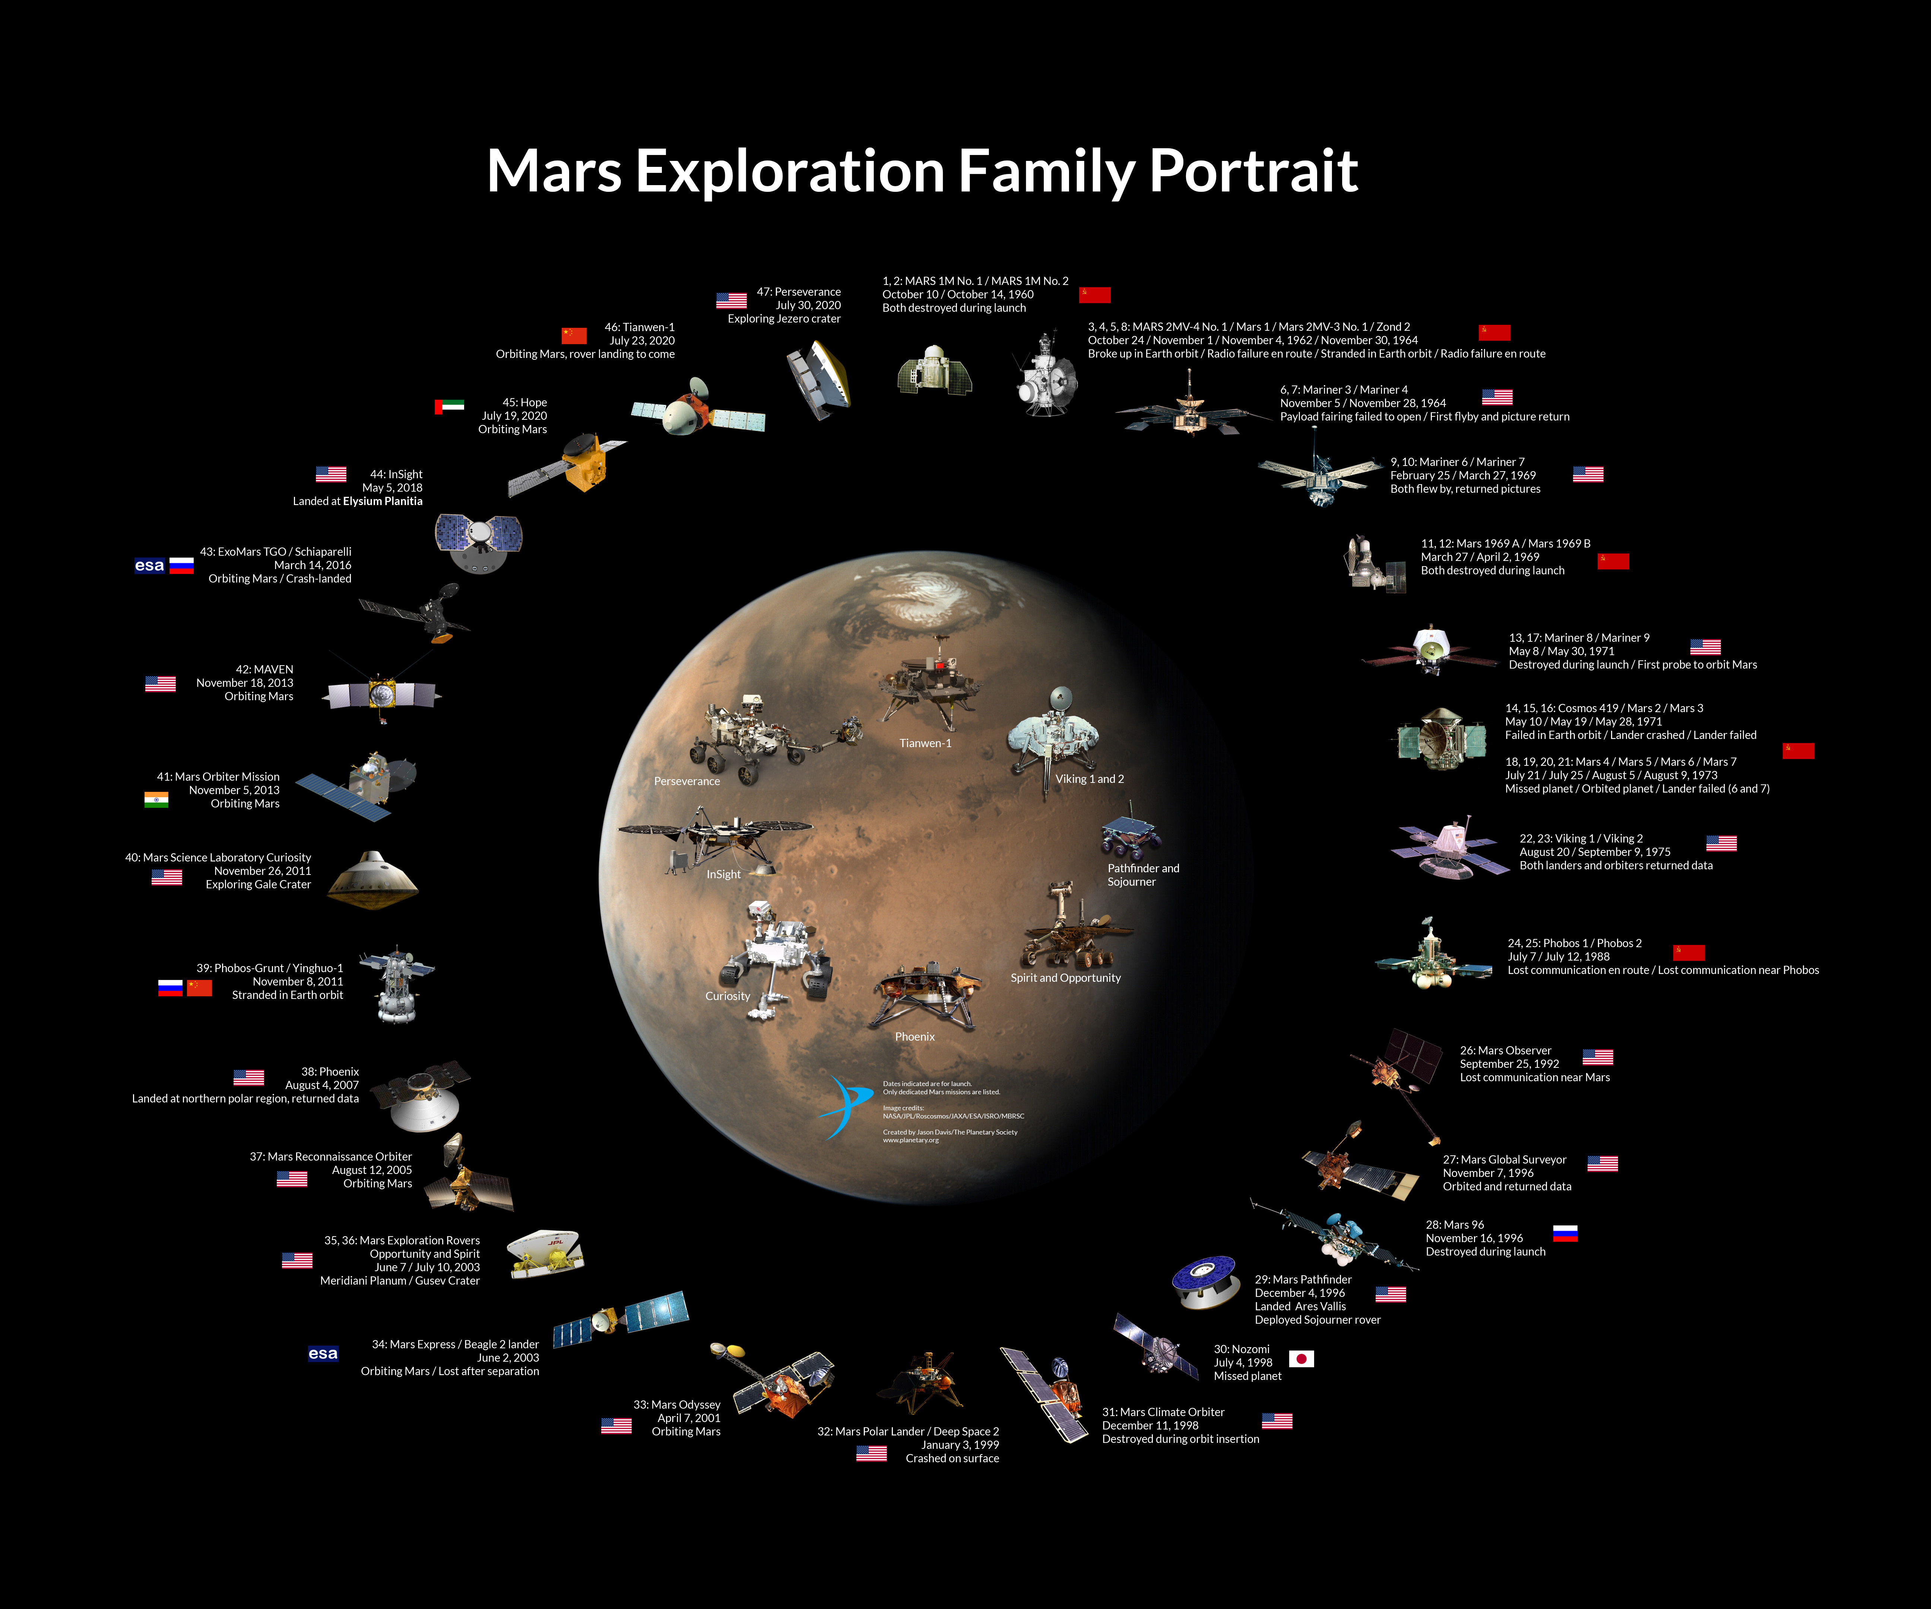

Slide 5
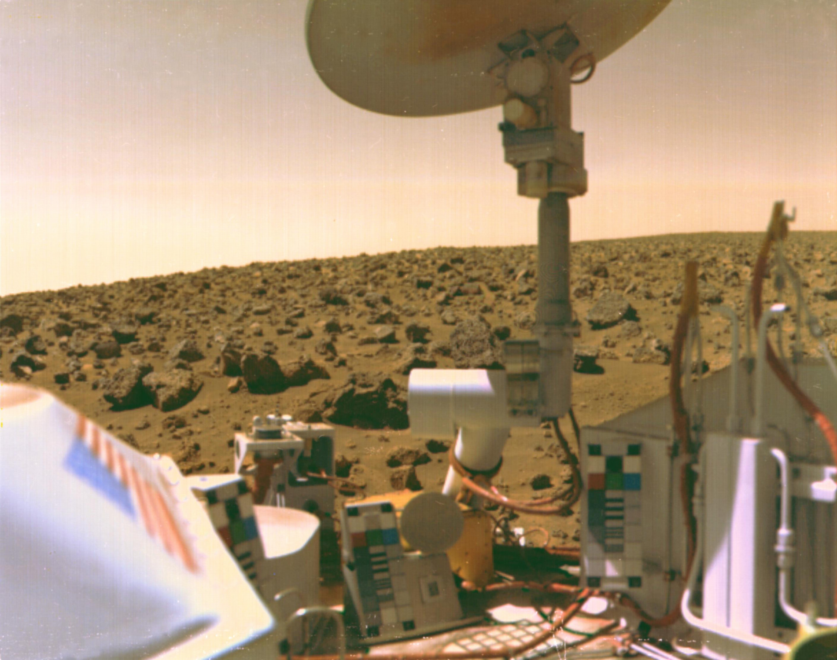
First seismometer on Mars: Viking mission (1976)
InSight was not the first seismometer on Mars! The Viking mission in 1976, which was the first successful US landing on mars, contained an onboard seismometer.
The main objective of the Viking mission to search for possible signs of life.
Unfortunately, the seismometer’s sensitivity to marsquakes was greatly diminished because it was on the lander deck, which was a noisy environment (it mostly recorded shaking from wind!).
No confirmed marsquakes 😢
seismometer

Slide 6
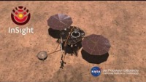
InSight mission overview

Slide 7
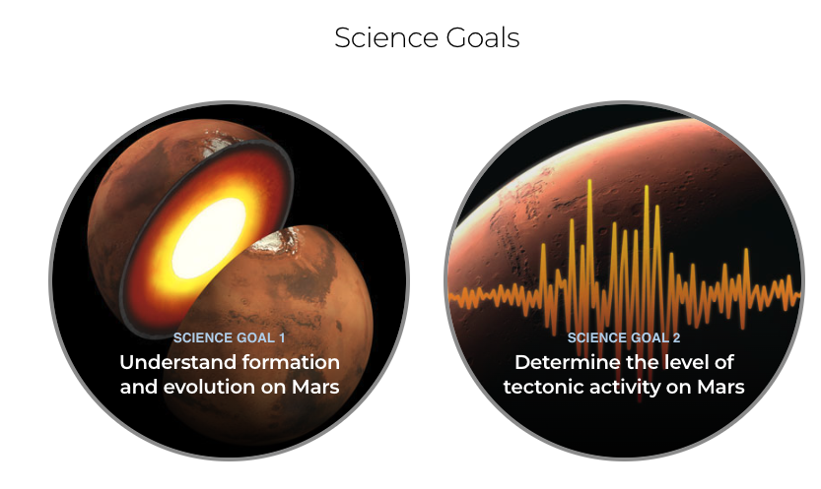

Slide 8
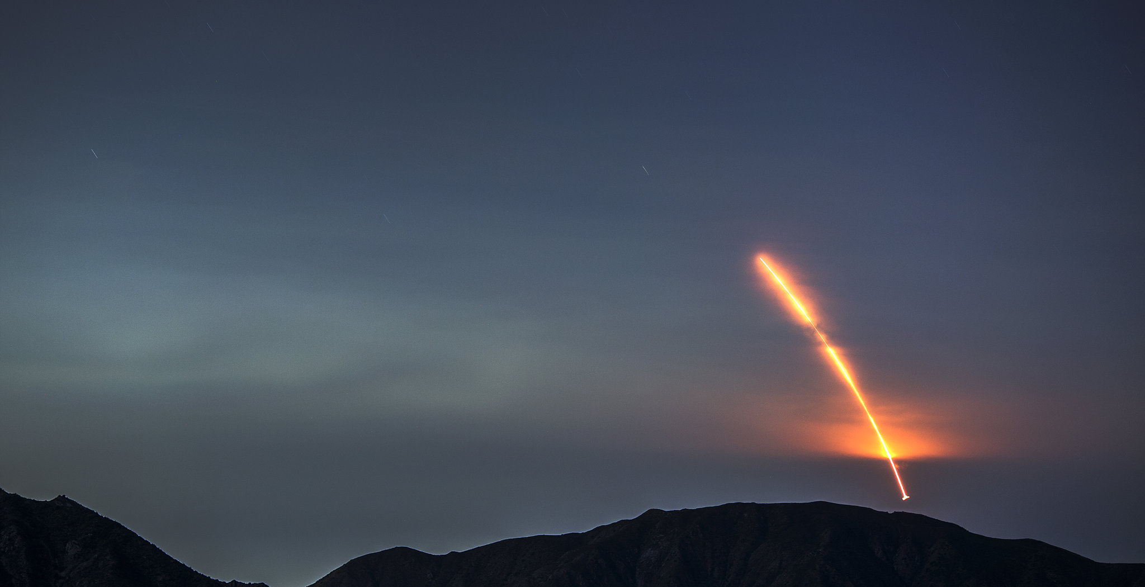
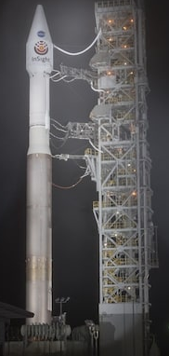
The InSight Mission
InSight: Interior Exploration using Seismic Investigations, Geodesy and Heat Transport
NASA Discovery Class Mission
Launched: May 5, 2018 (4:05 a.m. PT/7:05 a.m. ET) Launch Vehicle: Atlas V-401 Launch Location: Vandenberg Air Force Base, California (the first mission launched from there!) Landed: Nov. 26, 2018, at 11:52:59 a.m. PT (2:52:59 p.m. ET) Landing Site: Elysium Planitia, Mars Mission Duration: 2018- Dec. 15, 2022 (last contact)
Image Credit: David Mcnew/Getty Images

Slide 9
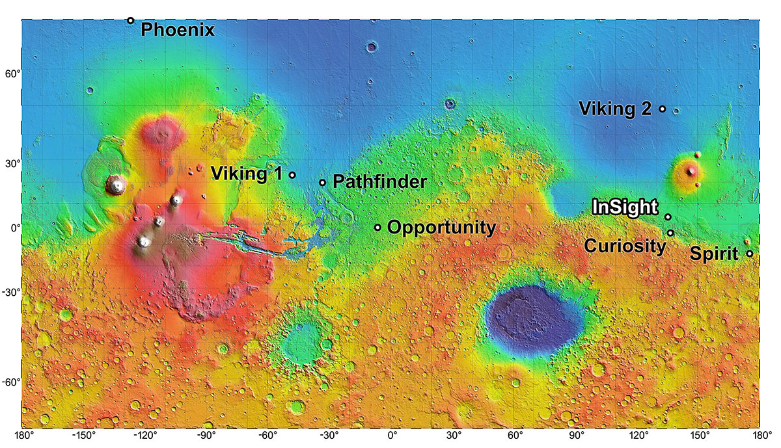
Landing site
InSight landed in Western Elysium Planitia, near boundary of north-south crustal dichotomy and Cerberus Fossae (recent volcanism)

Slide 10
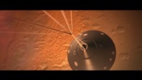

Slide 11
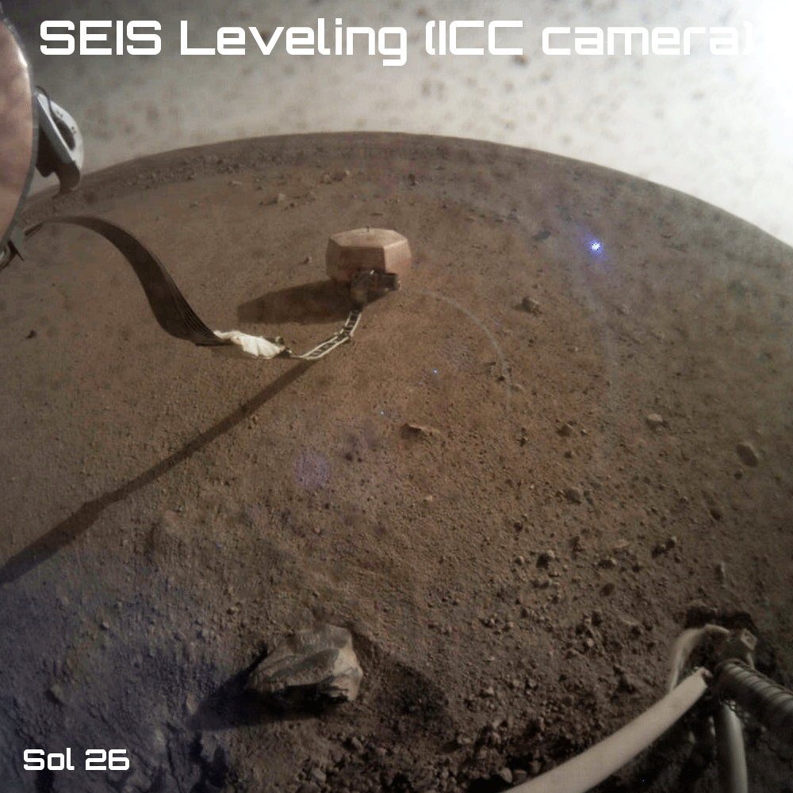
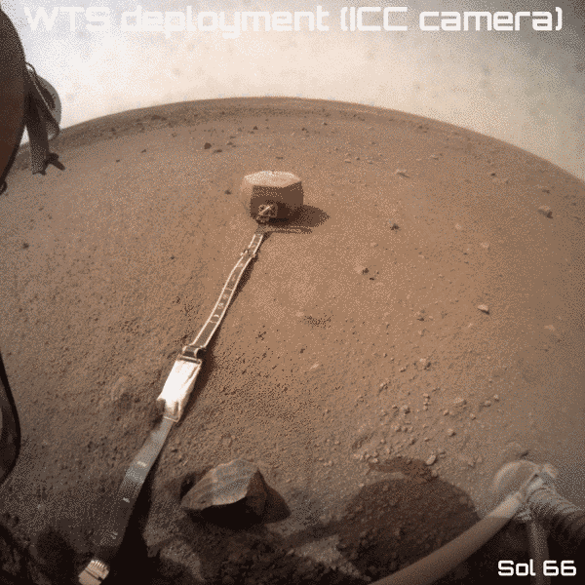
Deployment of the Wind and Thermal Shield

Slide 12
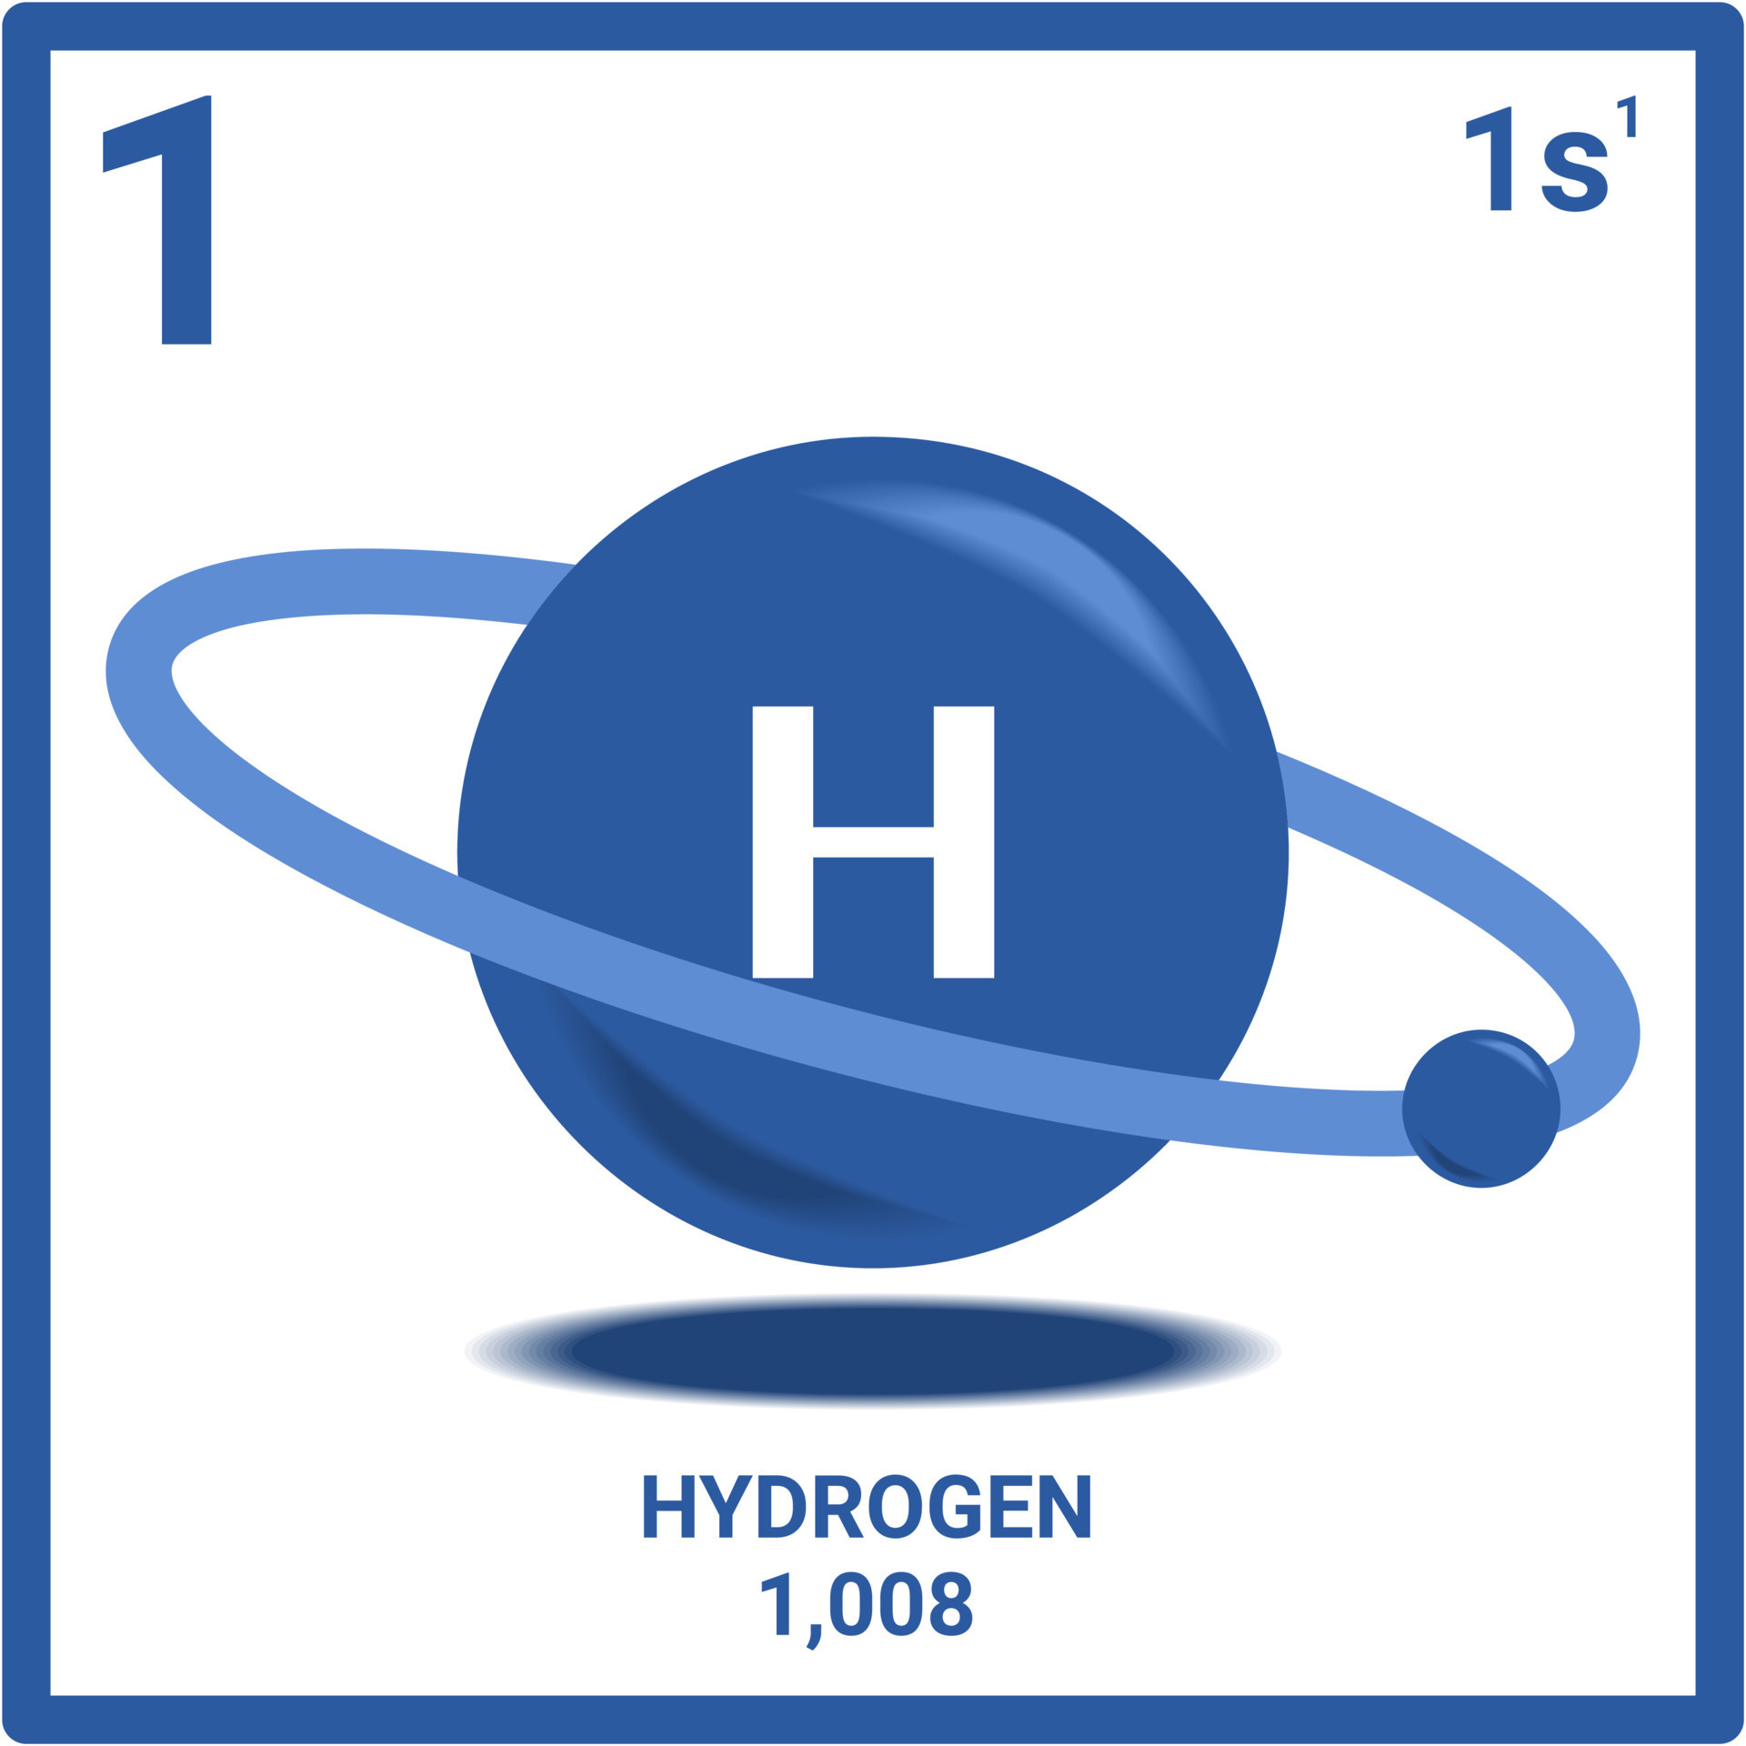
Seismic noise environment
Sensitive enough to pick up displacements on the order of 1 hydrogen atom!
Ocean waves on Earth
Quietest place on Earth
Quietest place on Mars is nearly 1000x quieter
Lognonne et al., 2020 (Nature Geoscience)

Slide 13
Understanding InSight data
How to read an InSight seismogram and spectrogram 101:
Winds are usually the loudest signal recorded by SEIS
Strongest during daytime
Most marsquake detections are at night
Vibrations of lander components show up as spectral lines
Frequencies decrease as spacecraft heats up during the day
2.4 Hz resonance is seen during quiet times
Most likely structural (waves reverberating in shallow layer)
Possibly related to flapping / twisting of solar panels
Transient signals are also commonly seen:
Related to microscopic tugs of the cable, etc.
Glitches, spikes, donks …
S0477a
InSight SEIS Waveform Data: Available in the IRIS DMC!

Slide 14
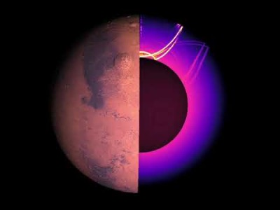
Wavefield simulations on Mars

Slide 15
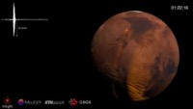
Wavefield simulations on Mars

Slide 16
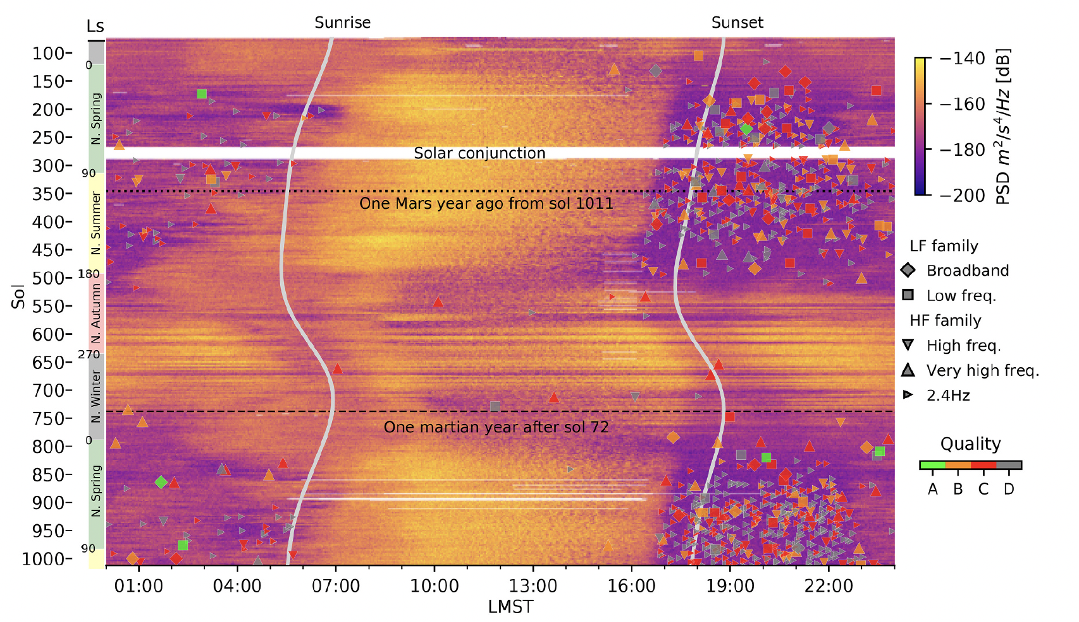
Marsquakes!
Marsquakes are typically observed during the early evening and night (i.e., when the background noise is quiet)
Marsquake detection is seasonal. The nights are not as quiet during the autumn and winter.
Ceylan et al., 2022

Slide 17
Types of marsquakes
Marsquakes are categorized according to their frequency content:
Broadband (BB)
energy from 0.1 Hz or less to 10 Hz
Low Frequency (LF)
energy below 2.4 Hz
2.4 Hz (2.4)
energy only at 2.4 Hz (local resonance?)
High Frequency (HF)
energy above 2.4 Hz
Very High Frequency (VF)
energy above 10 Hz
Super High Frequency (SF)
energy above 20 Hz
Giardini et al., 2020 (Nature Geoscience)

Slide 18
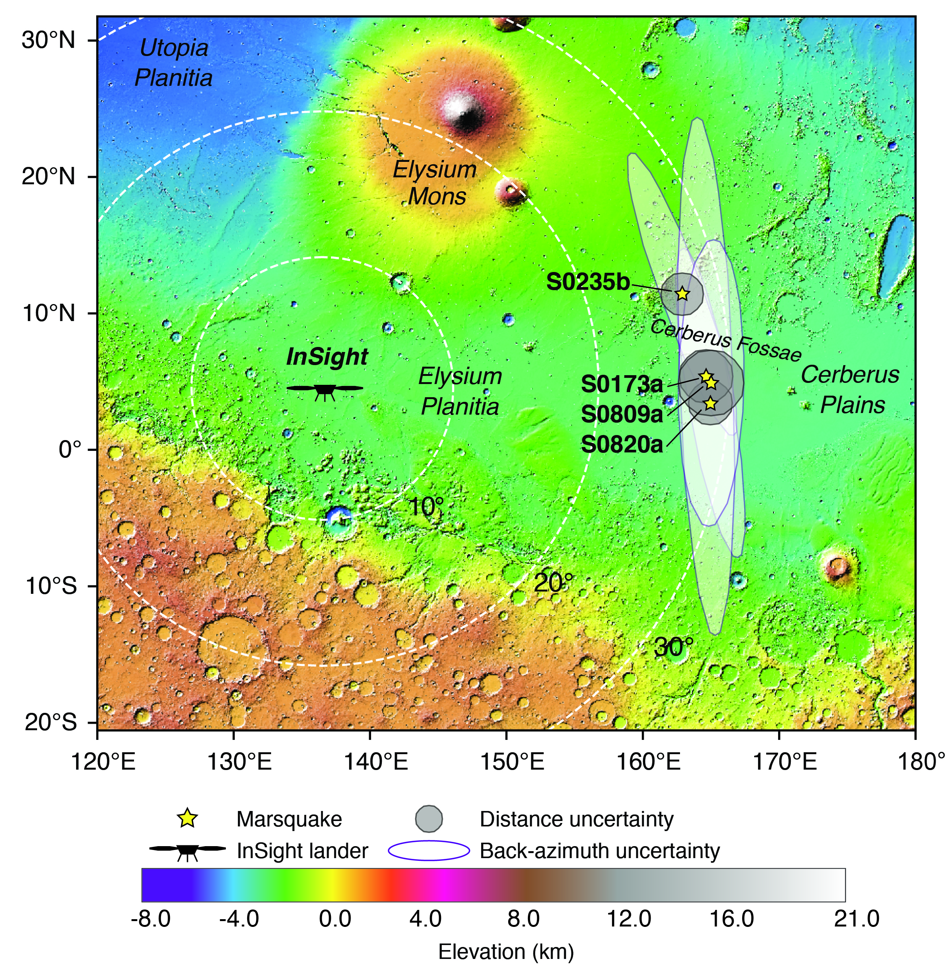
Marsquake statistics
Marsquake totals:
1317 events: 94 in LF family and 1223 in HF family
1383 in SF family
Kim et al., 2021
event type | total | A | B | C | D
HF (HIGH FREQUENCY) | 164 | 0 | 76 | 79 | 9
2.4_HZ | 989 | 0 | 49 | 354 | 586
VF (VERY HIGH FREQUENCY) | 70 | 0 | 25 | 34 | 11
BB (BROADBAND) | 37 | 8 | 9 | 15 | 5
LF (LOW FREQUENCY) | 57 | 6 | 11 | 21 | 19
«A» quality LF events can be located based on distance and azimuth
Many in Cerberus Fossae system → tectonic origin?
Starting on Sol 0976, things really get exciting!
SF (SUPER HIGH FREQUENCY) | 1383 | 0 | 0 | 323 | 1060

Slide 19
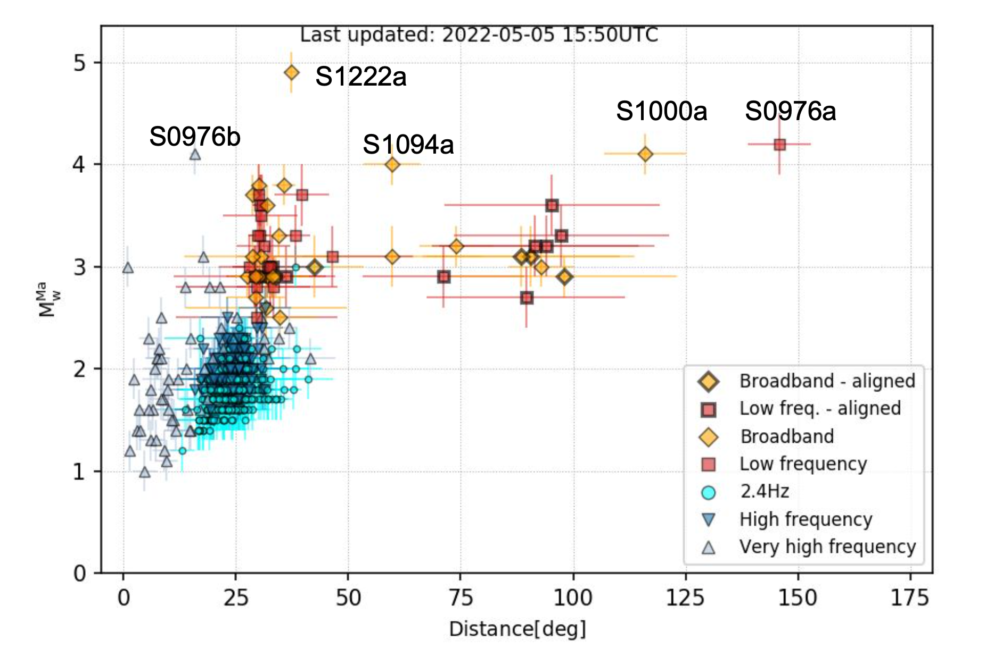
Marsquake distances and magnitudes
Ceylan et al., 2022

Slide 20
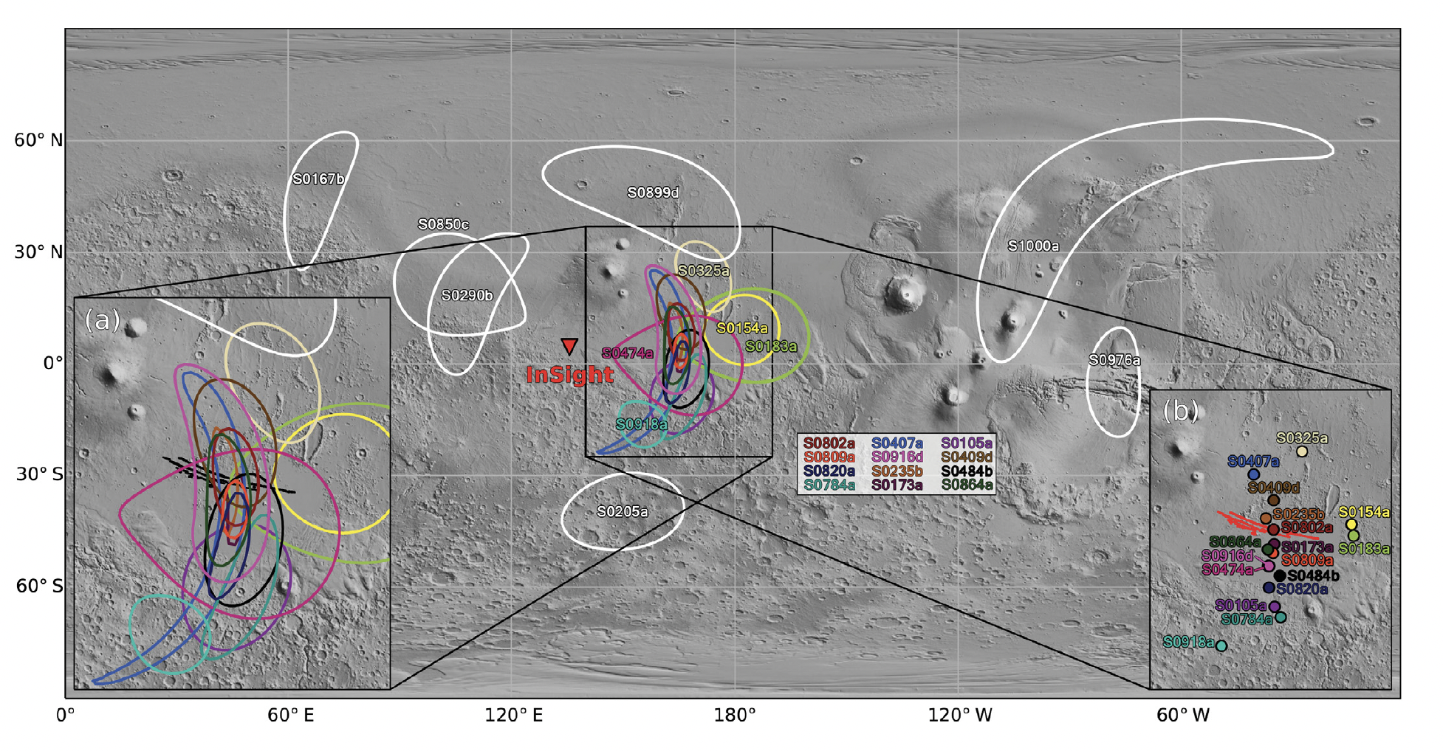
Marsquake locations

Slide 21
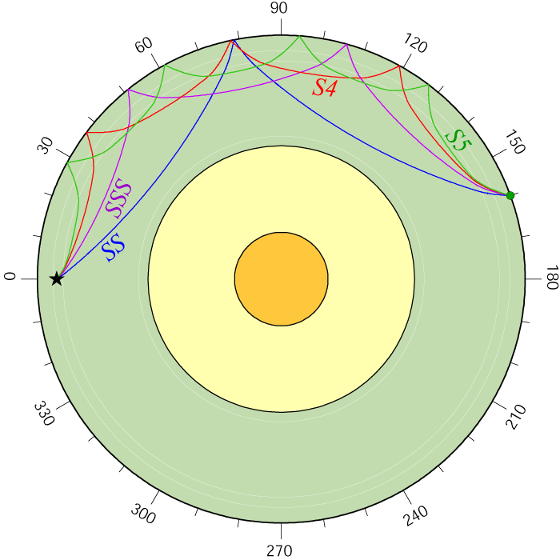
Event S0235b: The first Quality A ‘broadband’ marsquake
Arrivals of surface multiples – PP, PPP, SS, etc. – have also been identified
Khan et al., 2021 (Science)

Slide 22
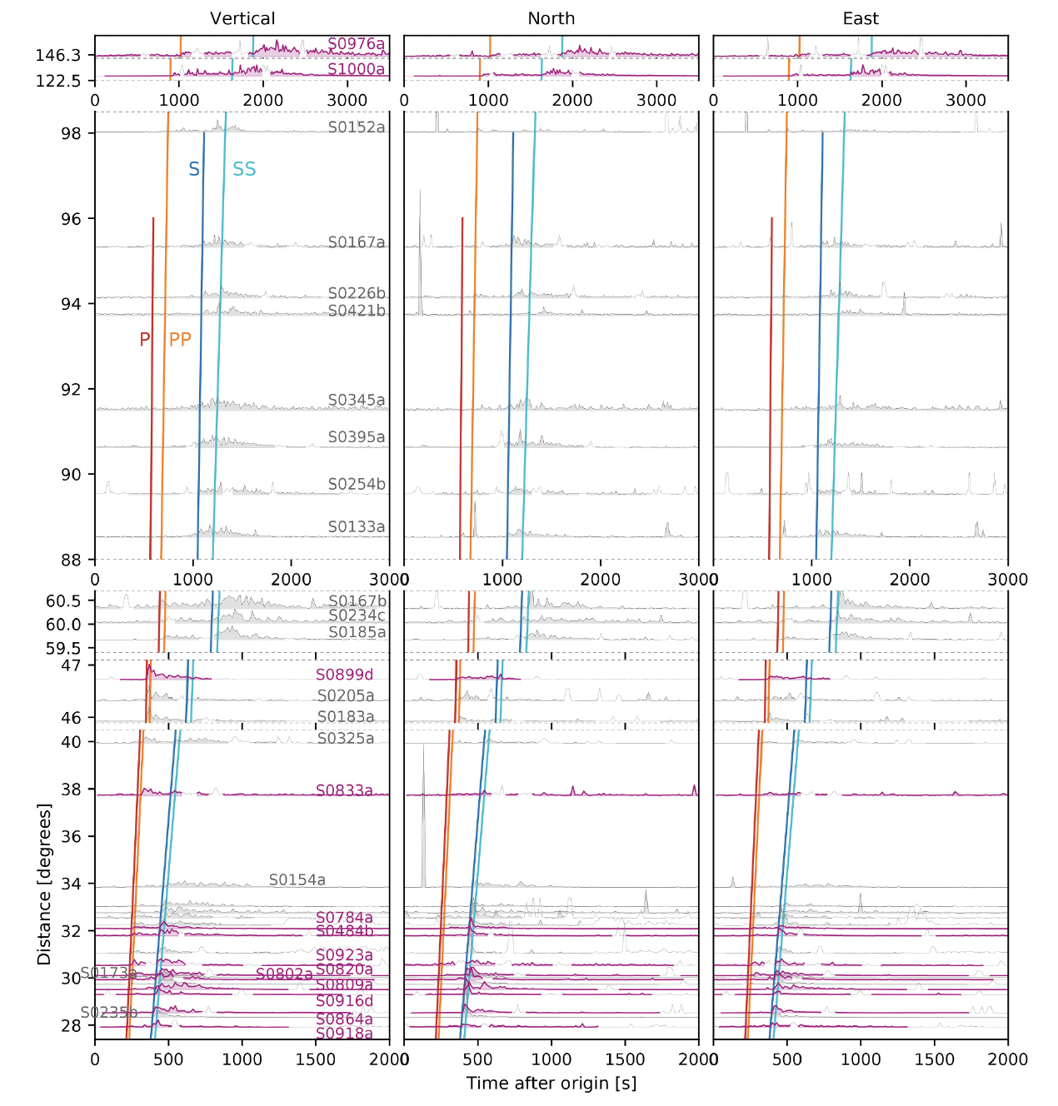
Martian record section
High quality LF and BB events can be plotted as a function of epicentral distance to explore seismic phases and their moveouts
Events closer than ~40 degrees have clear P and S wave arrivals (many in the Cerberus Fossae region)
S-wave arrivals diminish in strength between ~40 – 60 degrees (S-wave shadow zone?)
Not many events observed beyond ~90 degrees epicentral distance
S-wave shadow zone?
Ceylan et al., 2022

Slide 23
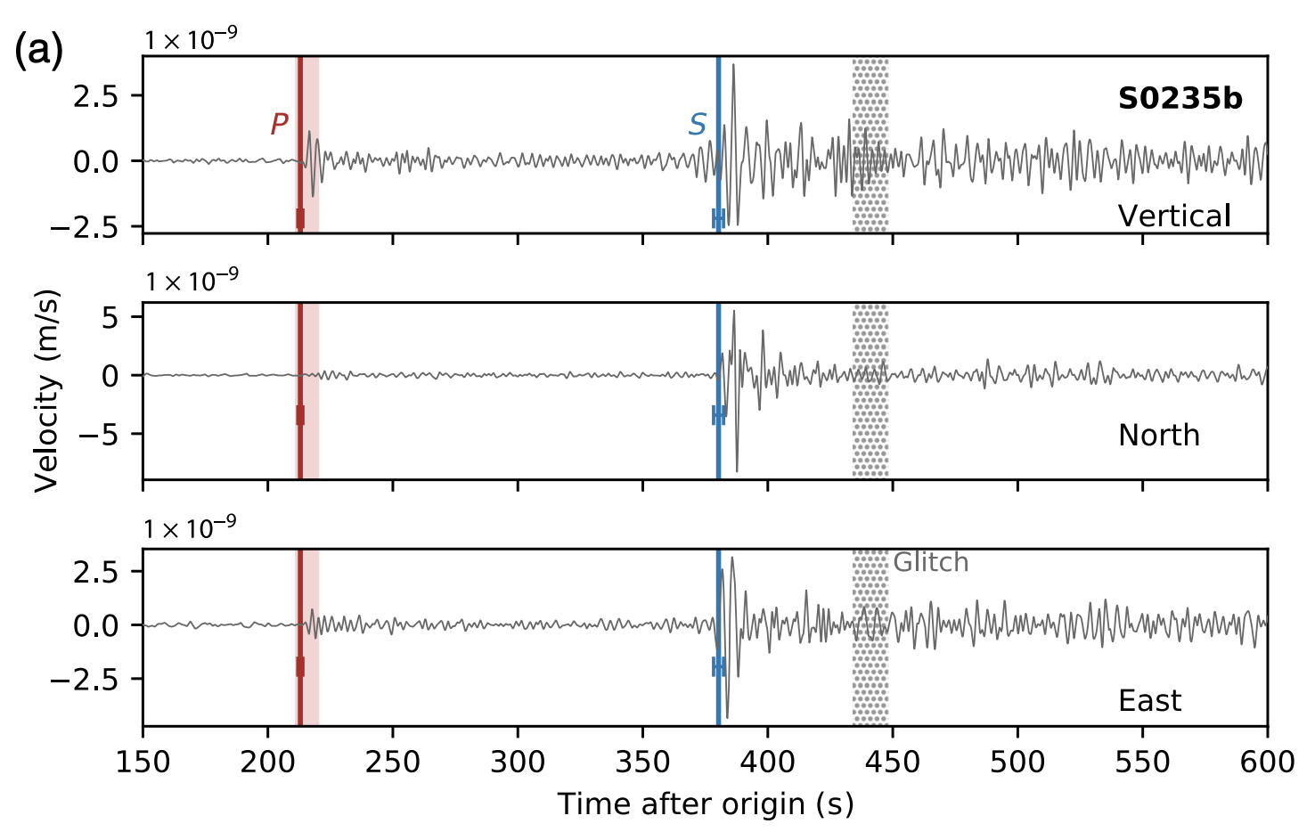
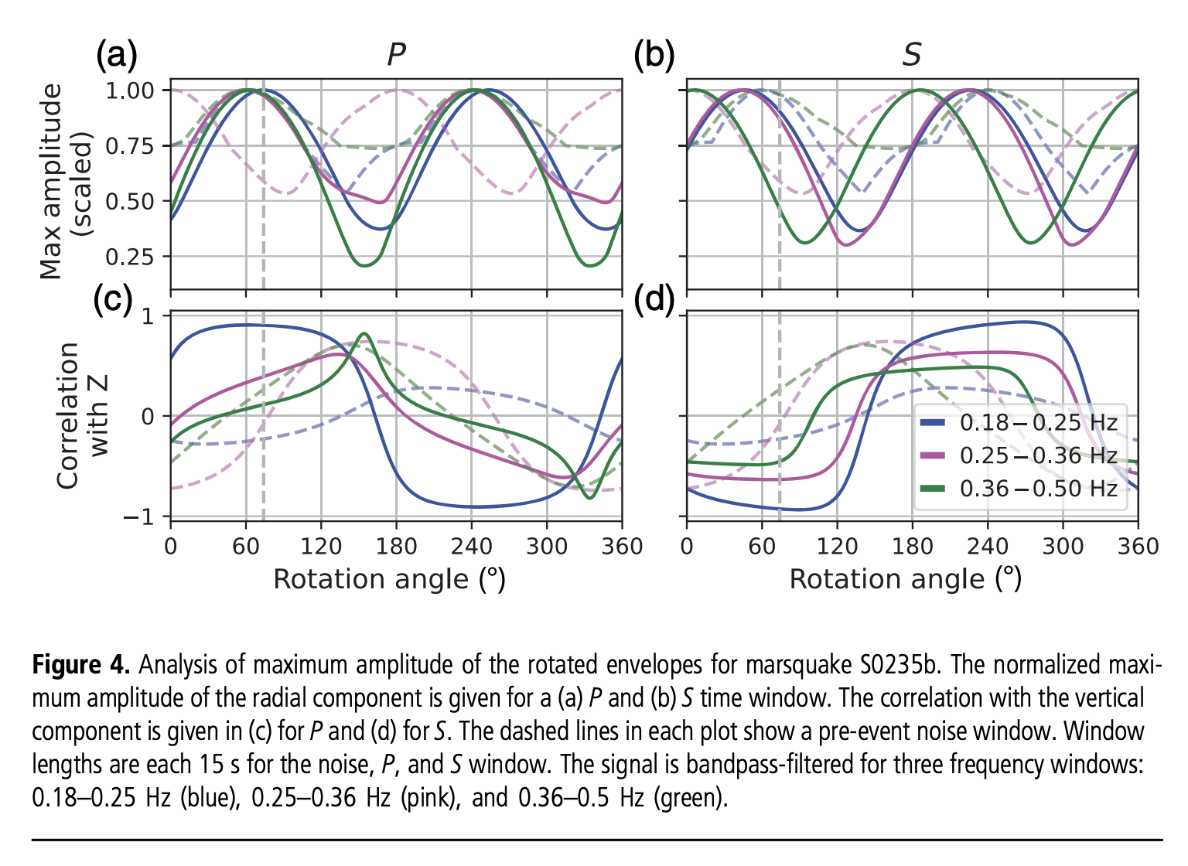
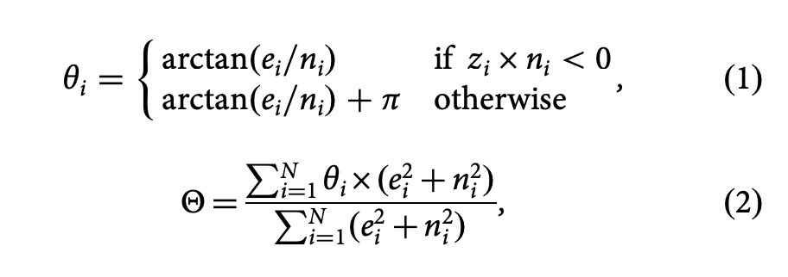
Locating marsquakes
Earthquakes are located using triangulation based on recordings from multiple stations. How do we do it with a single station?
S– P time gives an approximate distance, but what about direction?
Zenhausern et al., 2022

Slide 24
Two large events detected in core shadow zone!
First arrivals are PP, SS not P, S
S0976a, M 4.2 event, located in Valles Marineris, 146° distance
S1000a, M 4.1 event located ~127° distance
S1000a looks “strange”… too much high frequency energy compared to other broadband events

Slide 25
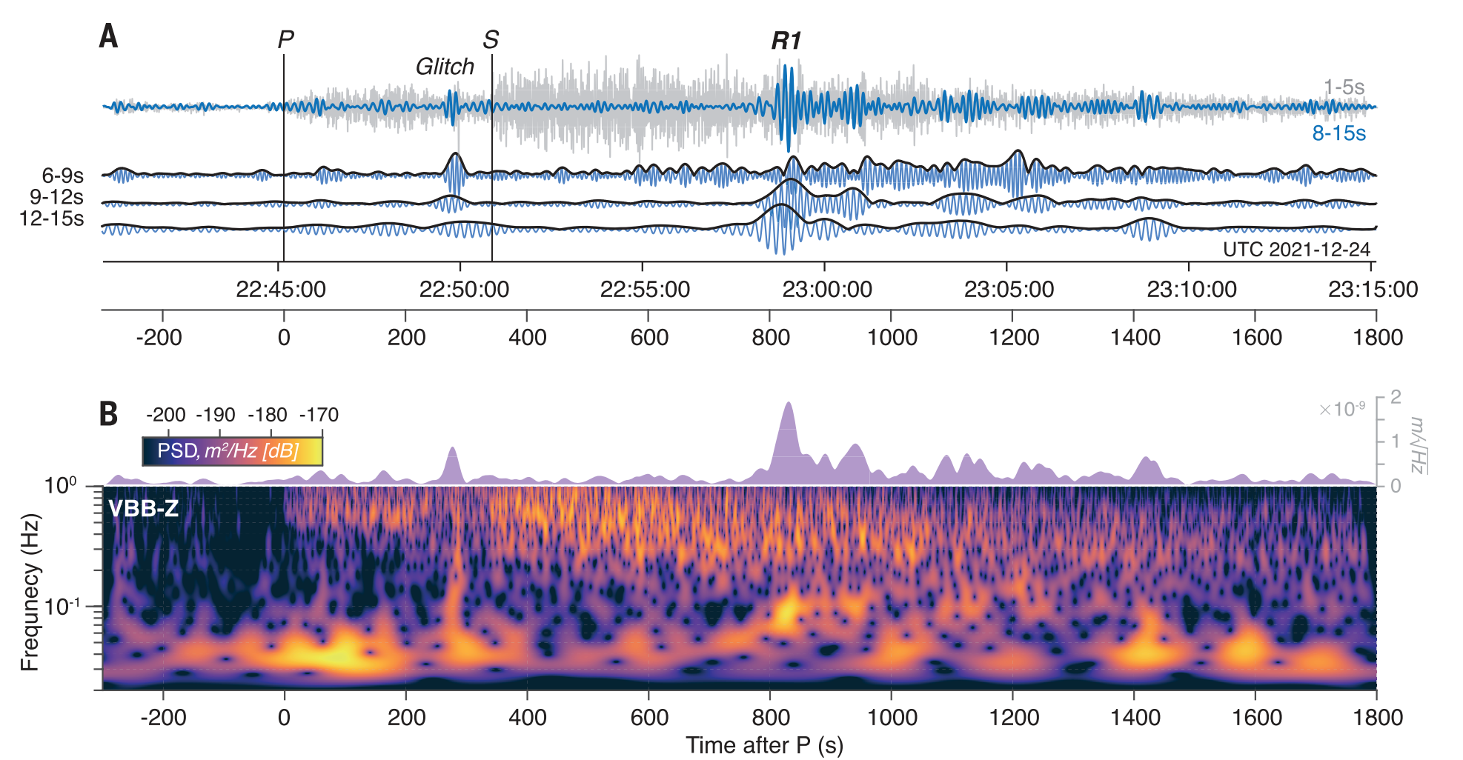
Event S1094b
Three months later, S1094b is detected: M4.0, 60° away
S1094b is also beautiful, but anomalously long in duration with high frequency content.
Waveforms from event S1094b exhibit clear Rayleigh waves between ~8 - 15 s period
Kim et al., 2022, Science

Slide 26
What is going on?
Based on the inferred source region from MQS determined distance and back azimuth, the orbital imager CTX took a closer look…
confirmed impact!
Posiolova et al. 2022, Science (10/28!)

Slide 27
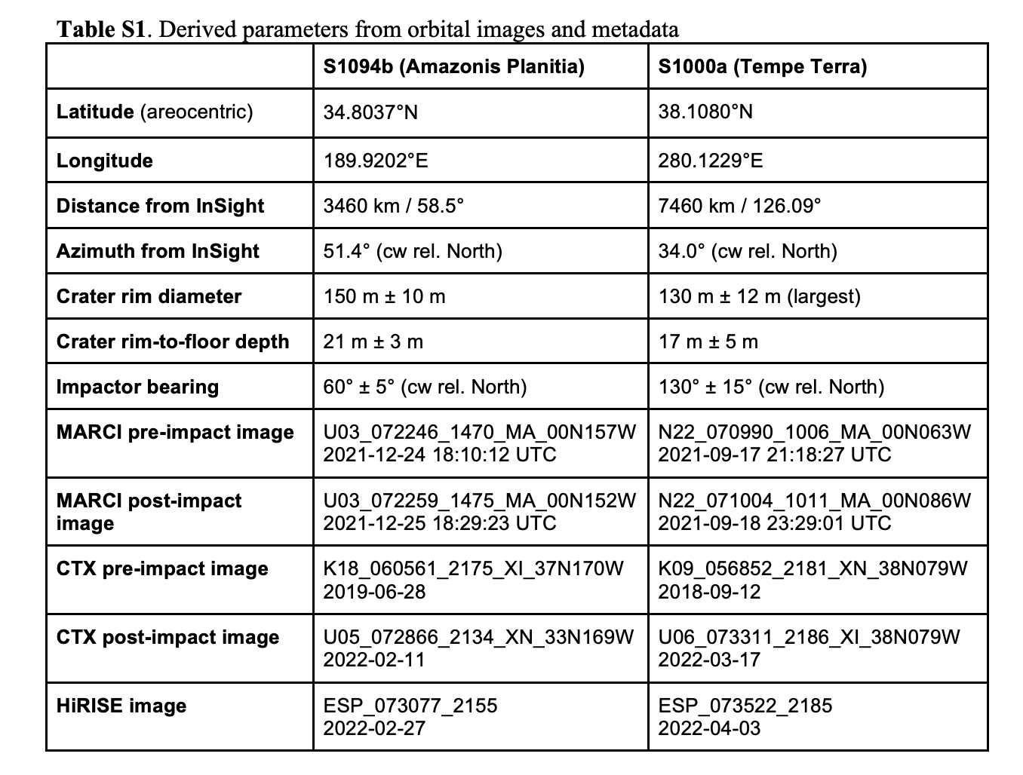
Two impacts!
Orbital imaging also confirms S1000a was caused by an impact

Slide 28
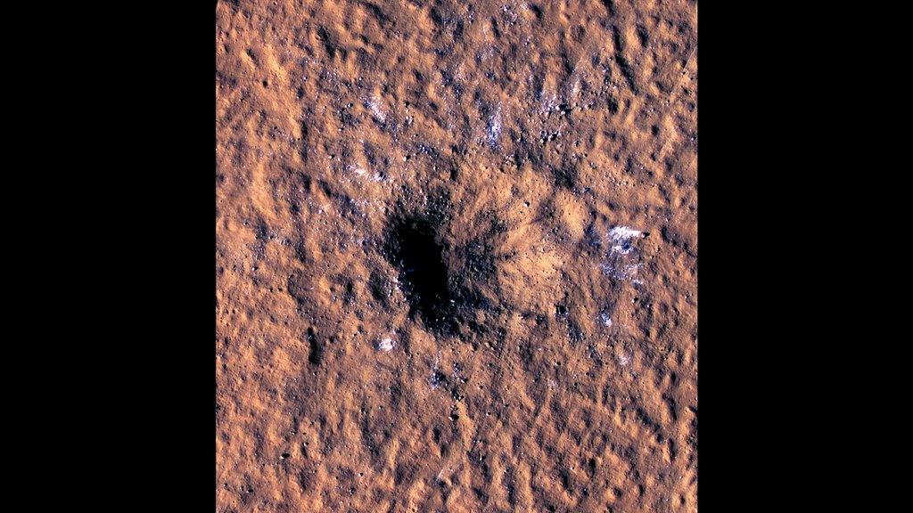
Boulder sized blocks of ice
(closest to the equator that ice has ever been found!)

Slide 29
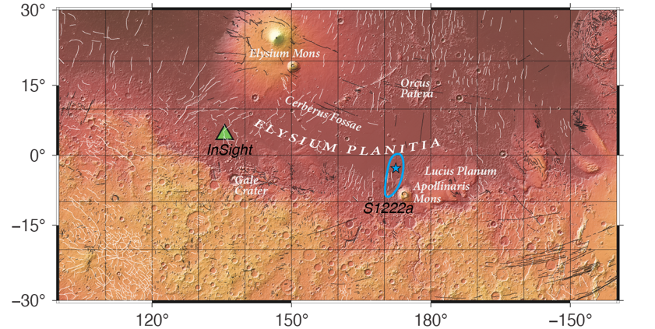
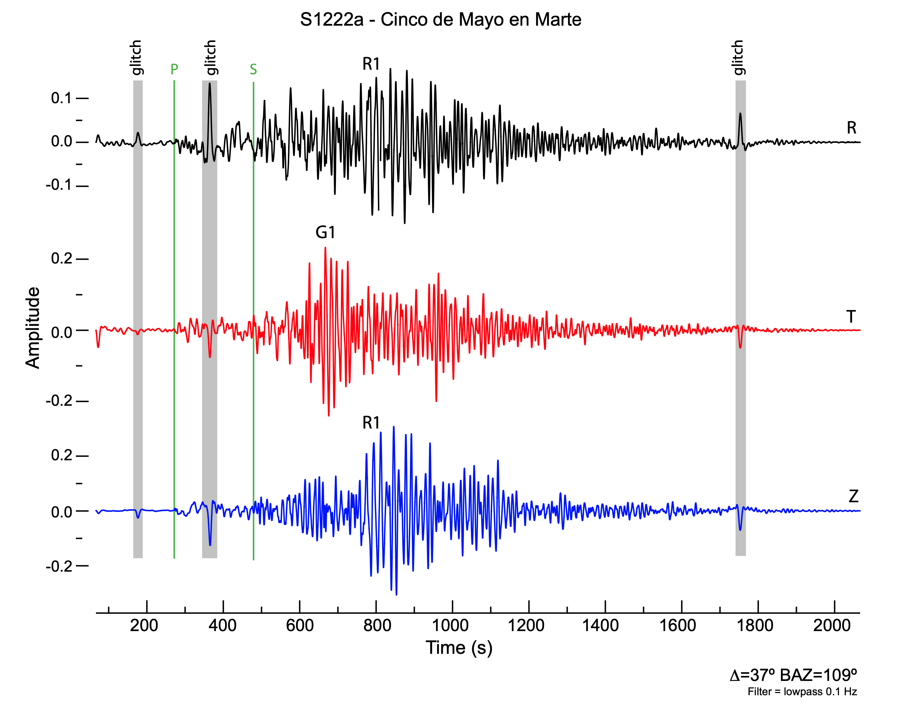
The largest marsquake (event S1222a)
Maguire et al., (submitted)
On May 4, 2022, InSight recorded the largest observed masquake (S1222a), with an initial magnitude estimate of Mw 4.7.
The event was located ~37 degrees to the ESE of InSight, near Apolinaris Mons (not a Cerberus Fossae event!)
Not an impact!
In addition to being just the third event with clearly observed Rayleigh waves, it is the only event observed with Love waves.
Beghein et al., (2022)

Slide 30
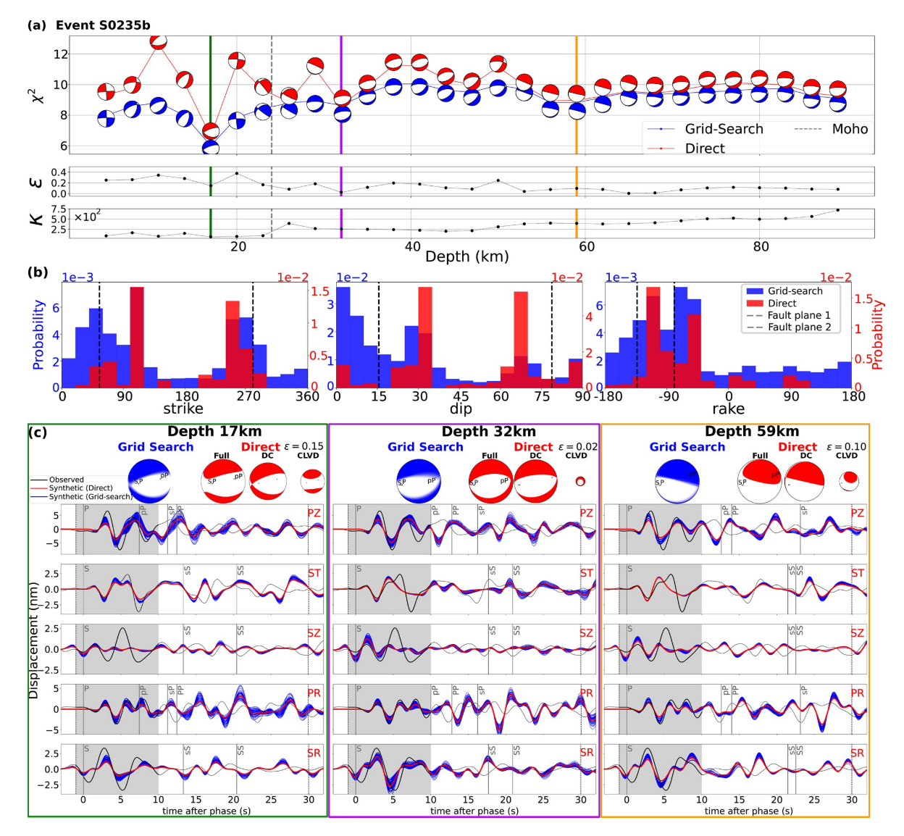
Focal mechanisms of marsquakes
Waveform fitting of body waves (P and S) from Cerberus Fossae events suggests normal faulting
Orientation of fault planes is consistent with extensional regime
Event depths can not be definitively determined (likely in the upper 50 km)
Brinkman et al., (2021)

Slide 31
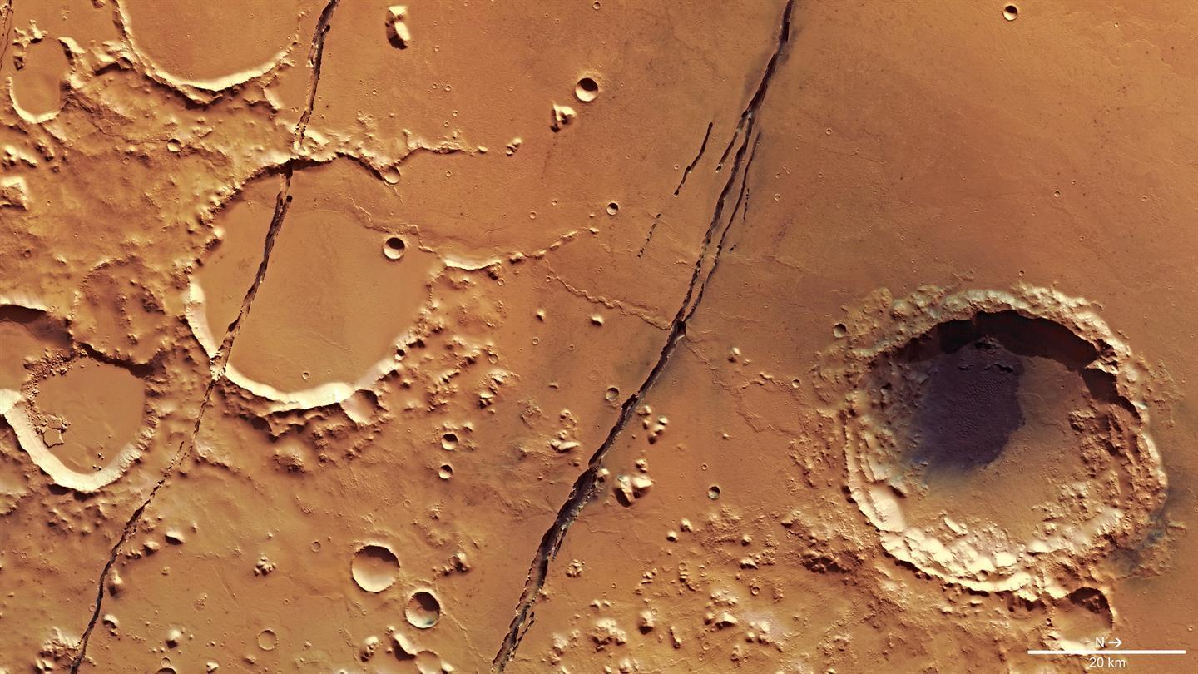
Cerberus Fossae (Rifts of Cerberus)
young volcanic plains
(~ 10 Myr)

Slide 32
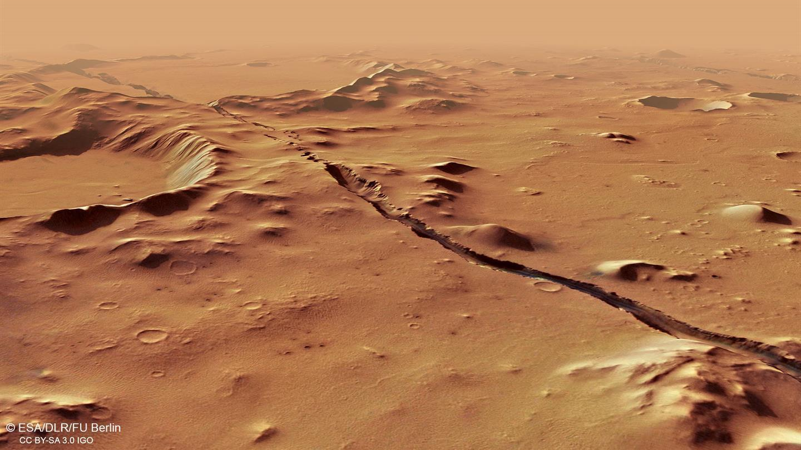

Slide 33
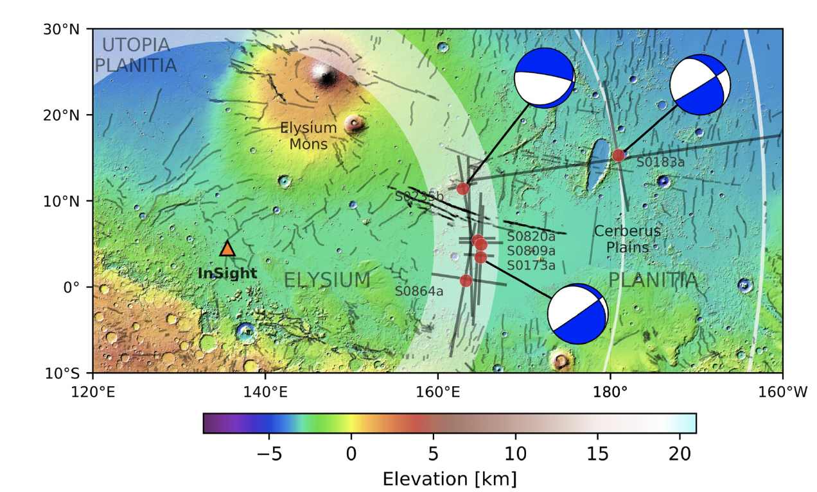
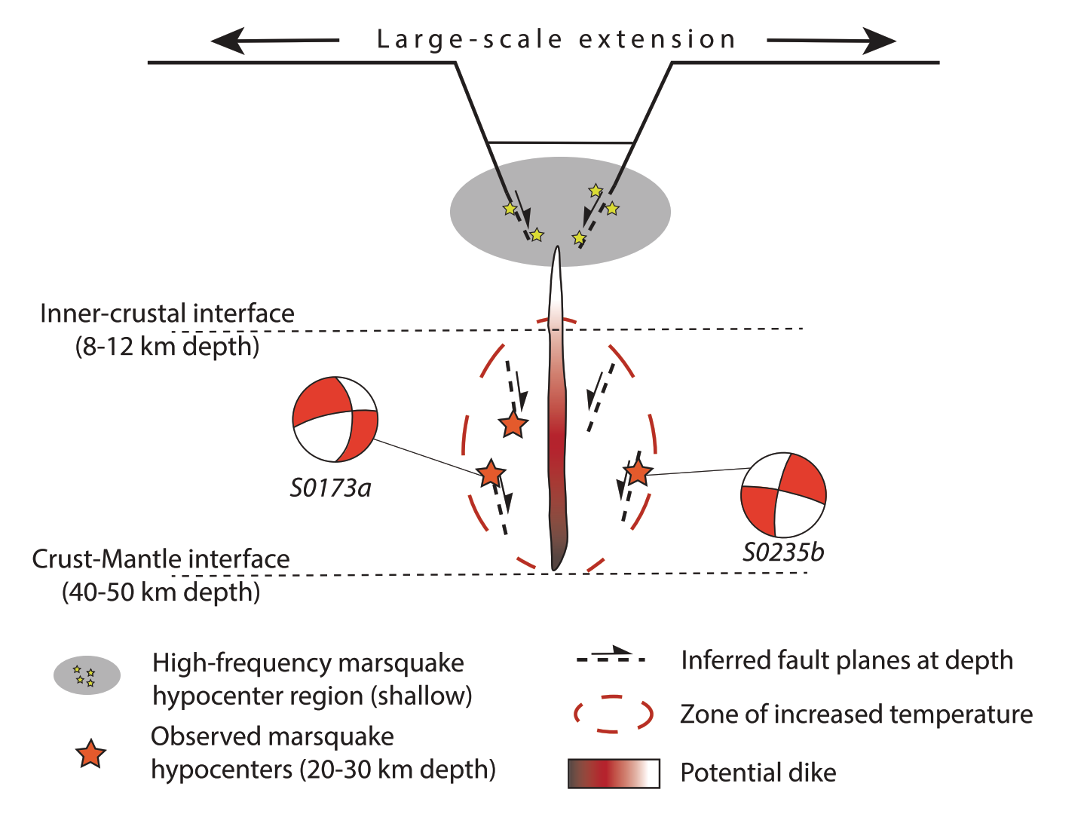
Tectonics in Cerberus Fossae
HF events in Cerberus Fossae are likely related to shallow seismicity in brittle crust
BB events likely indicate mid-crustal faults in warmer/ weaker crust
Extension due to dike instrusion?
Stahler et al., (2022)

Slide 34
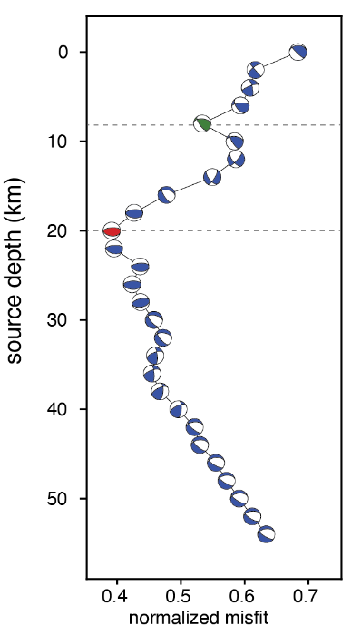
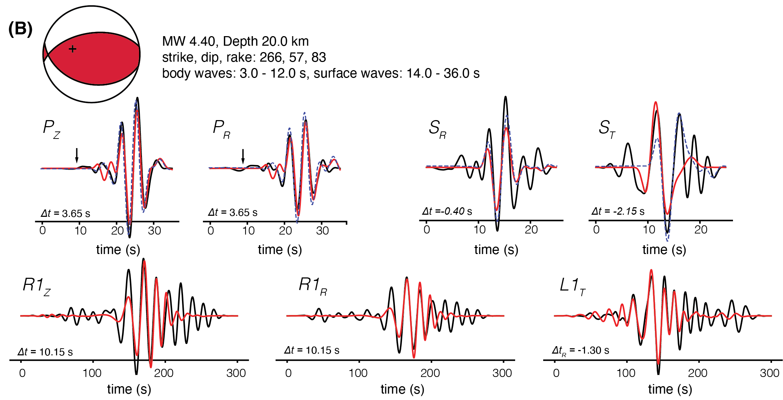
S1222a focal mechanism
Evidence for thrust faulting on Mars?

Slide 35
Mapped compressional faults

Slide 36
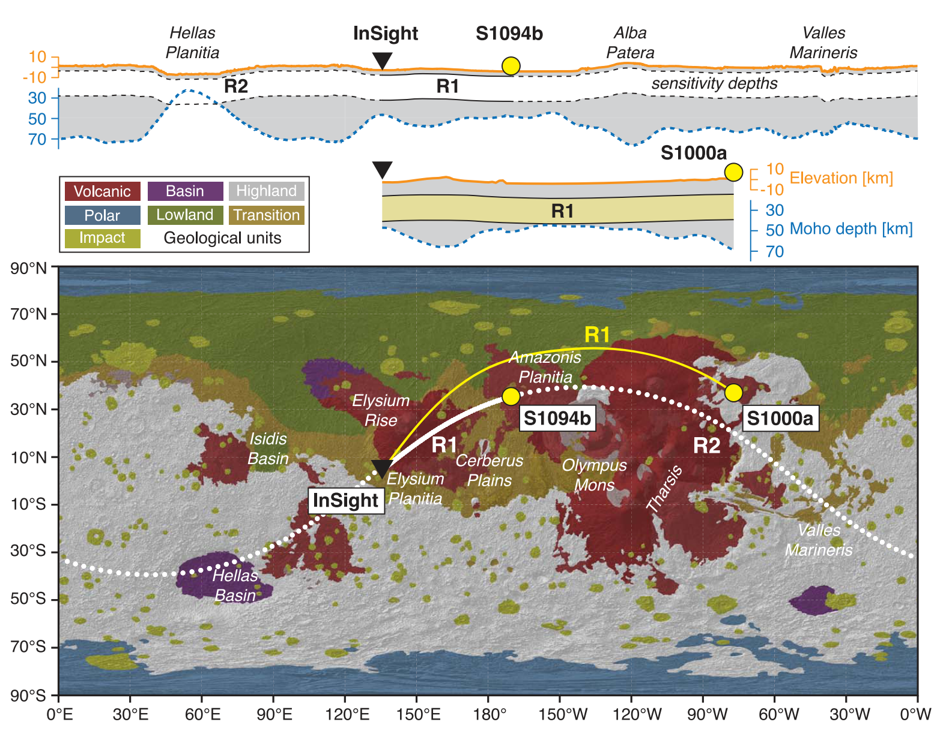
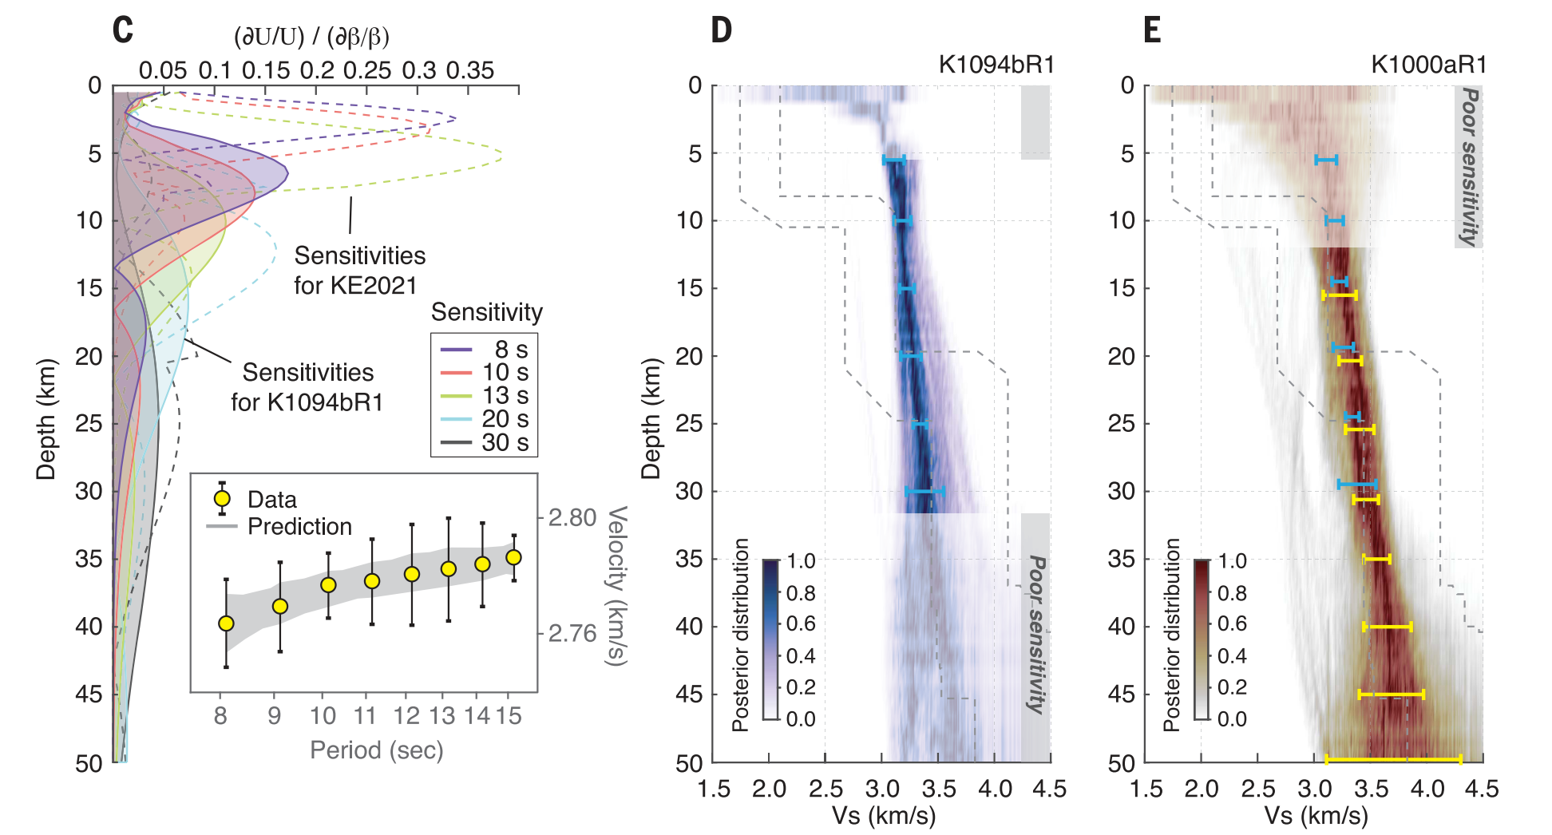
Surface wave inversion for crust and upper mantle structure
Velocity of surface waves depends on period
Rayleigh wave group velocity dispersion from both S1094b and S1000a
Crustal structure beneath lander is not representative of average Mars
Faster velocities suggest lower porosity or presence of subsurface ice
Either case implies higher density → implications for gravity modeling for global crustal thickness
Kim et al., 2022, Science

Slide 37
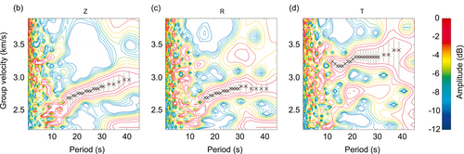
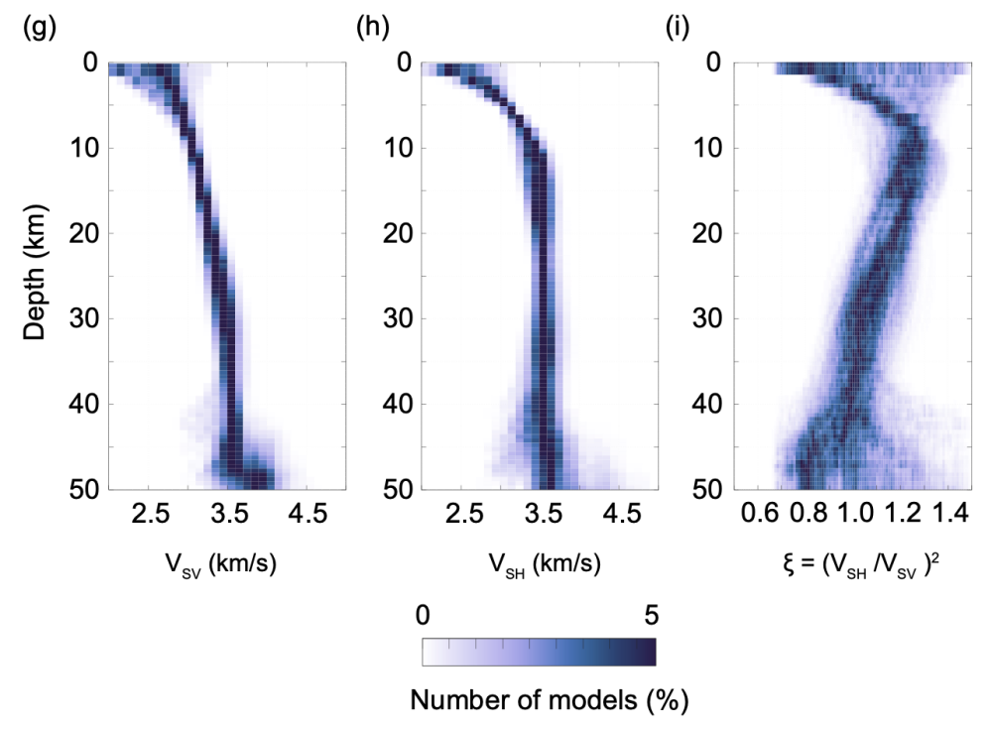
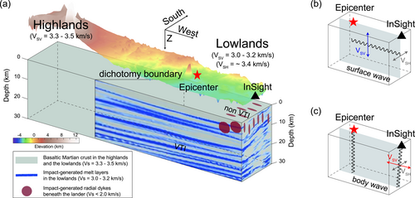
Radial anisotropy
Beghein et al., (2022)
Based on joint inversion of Rayleigh and Love waves from S1222a, region of strong positive radial anisotropy found (VSH > VSV)
Results imply strongly layered crust along propagation path (layered intrusions from impact?)

Slide 38
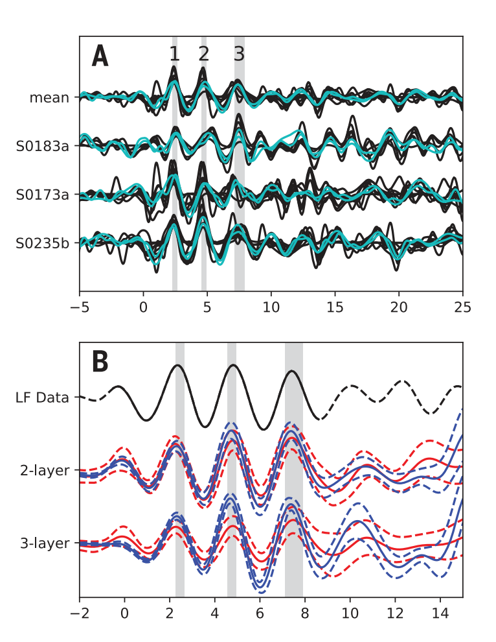
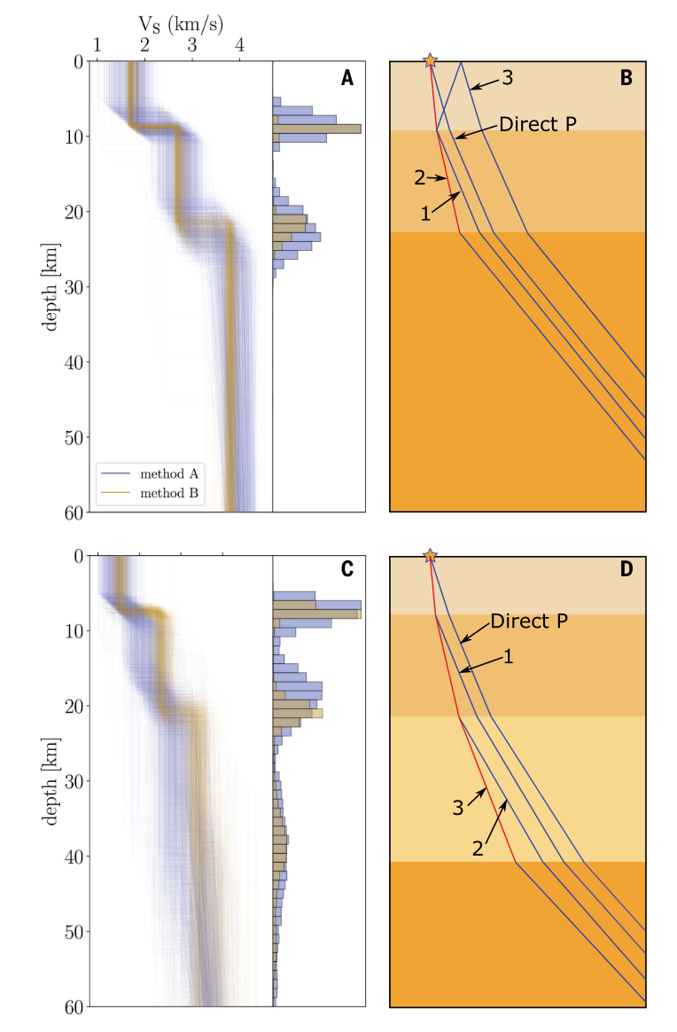
Crustal structure from receiver functions
Radial P-to-S receiver functions were calculated for high quality BB / LF events
Stacked RFs reflect the crustal structure below InSight
Three prominent positive pulses following the P-wave arrival indicate a crust with either 2 or 3 layers
Knapmeyer-Endrun et al., 2021

Slide 39
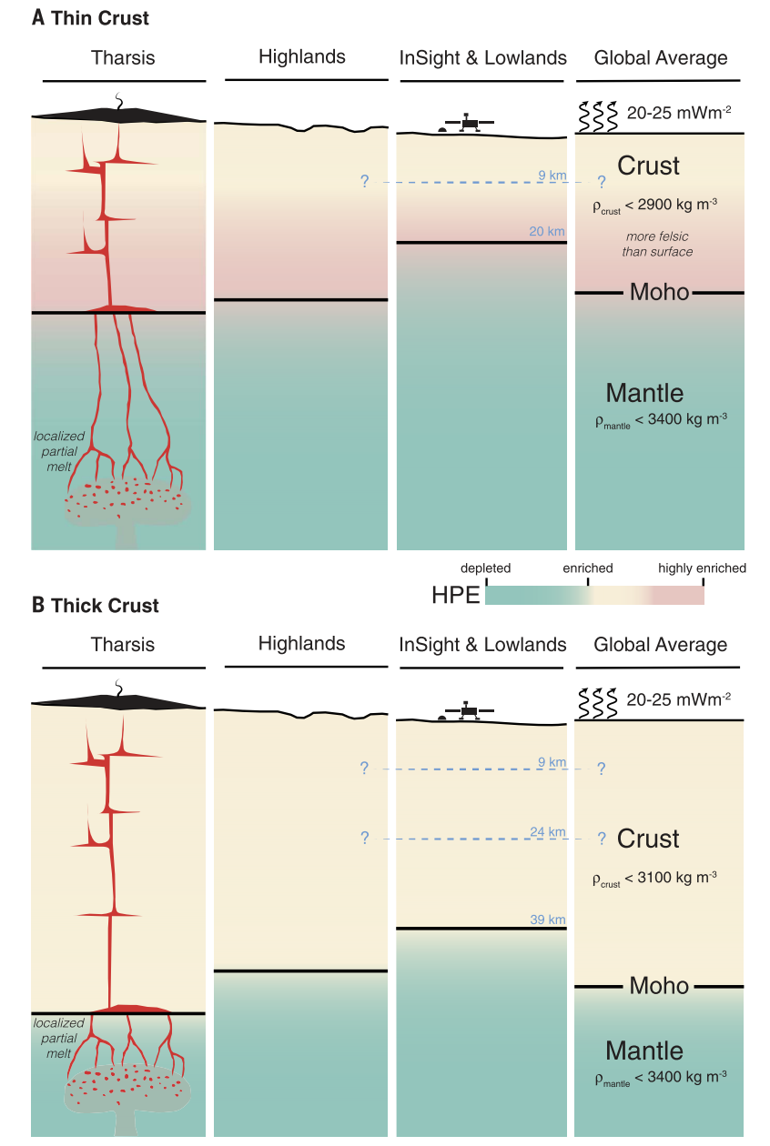
'Thick’ and ‘Thin’ models of the crust
Additional work by Kim et al., (2021, JGR) uses PPds and Sdp receiver functions to show that the 2-layer model is unlikely

Slide 40
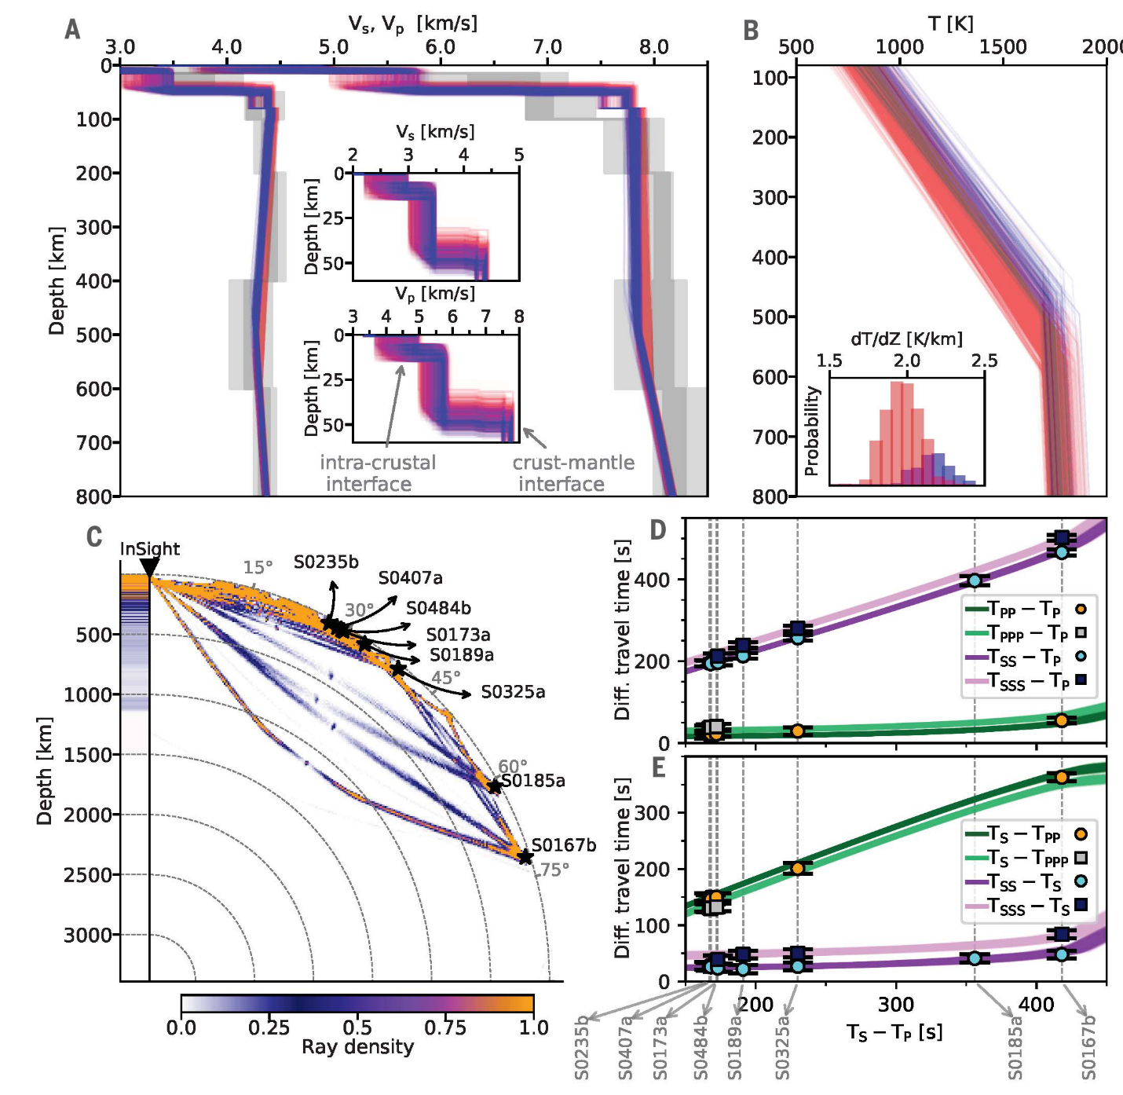
Mantle velocity structure
Differential travel times of high-quality BB and LF events were used to invert for seismic velocity and thermal structure
Geophysical inversions use apriori information from mineral physics and thermodynamics
Thermal lithosphere is estimated to be between 400 – 600 km (much thicker than Earth!)
Mantle potential temperature ~1600 – 1700 K
Khan et al., 2021, Science

Slide 41
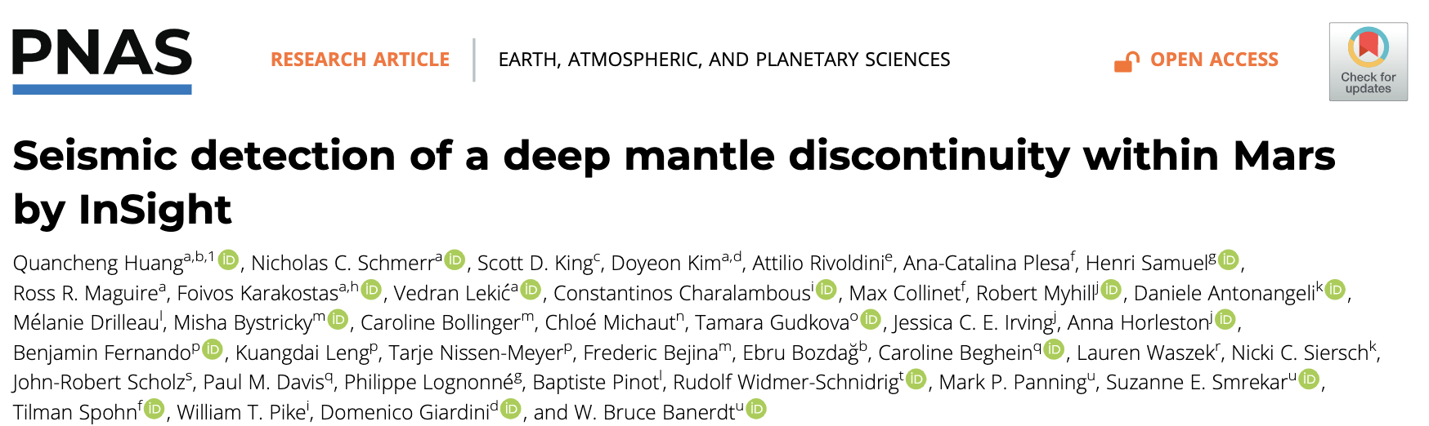
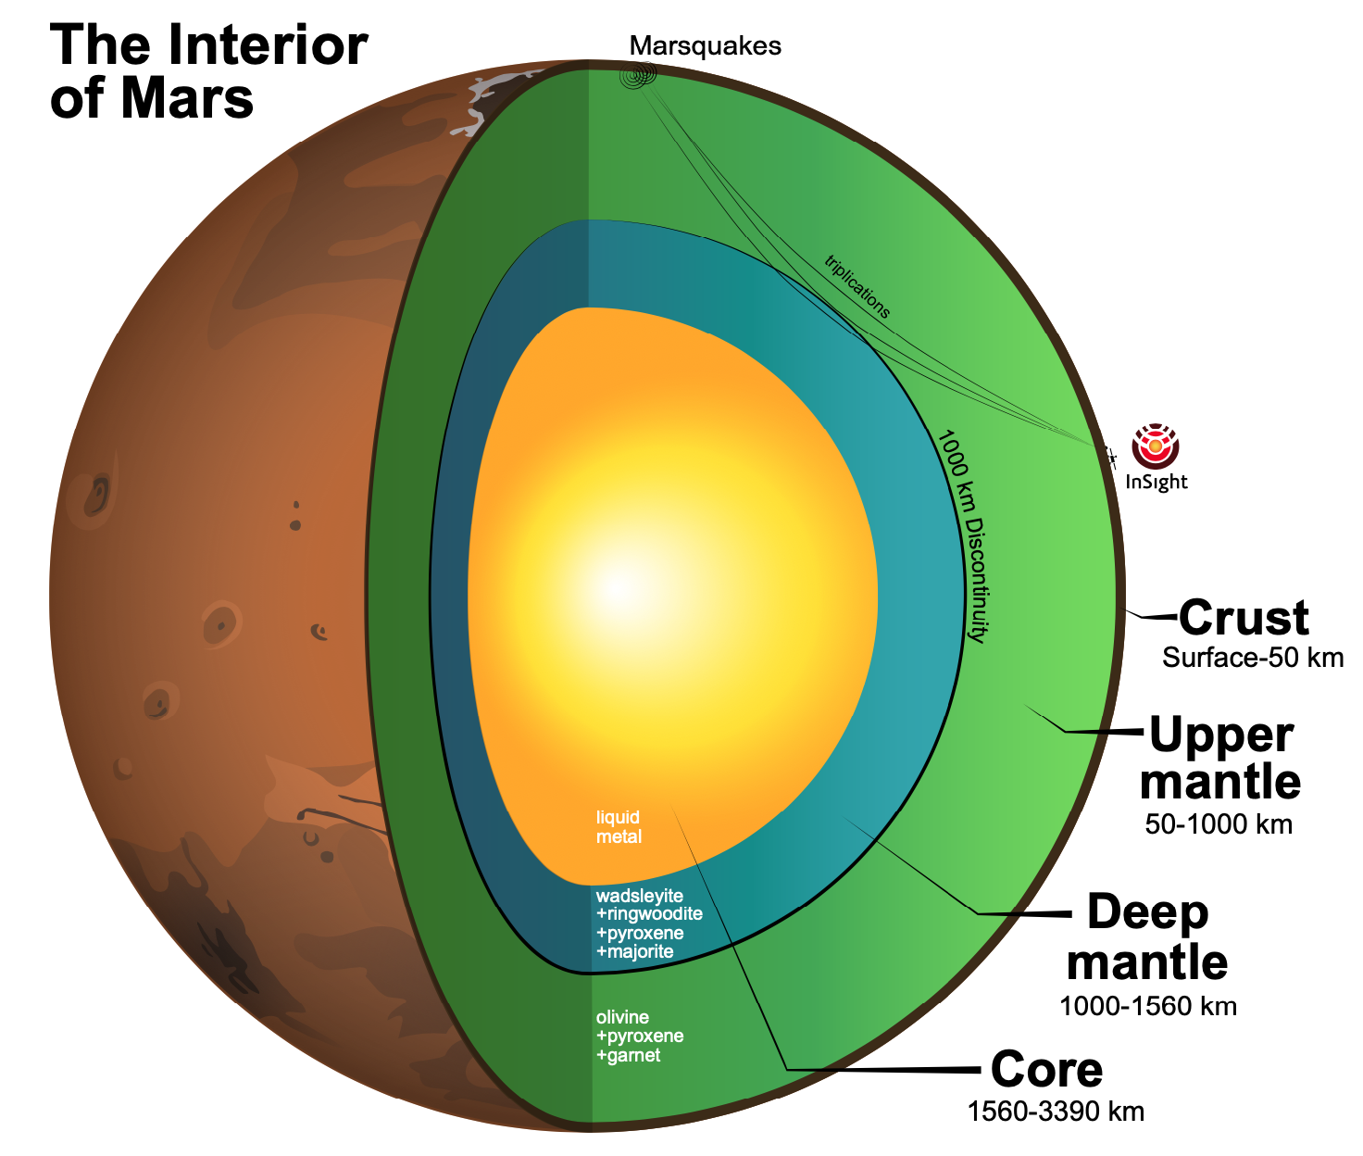
Martian mantle transition zone
Triplicated P and S waves that bottom in the lowermost mantle
The 410 equivalent on Mars arises from the transition from olivine to post-olivine phases (wds, rw) + maj and px
Large size of the core precludes the presence of a bridgmanite + ferropericlase lower mantle

Slide 42
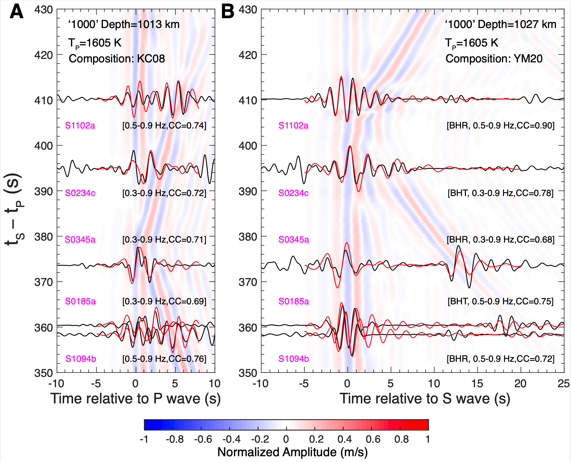
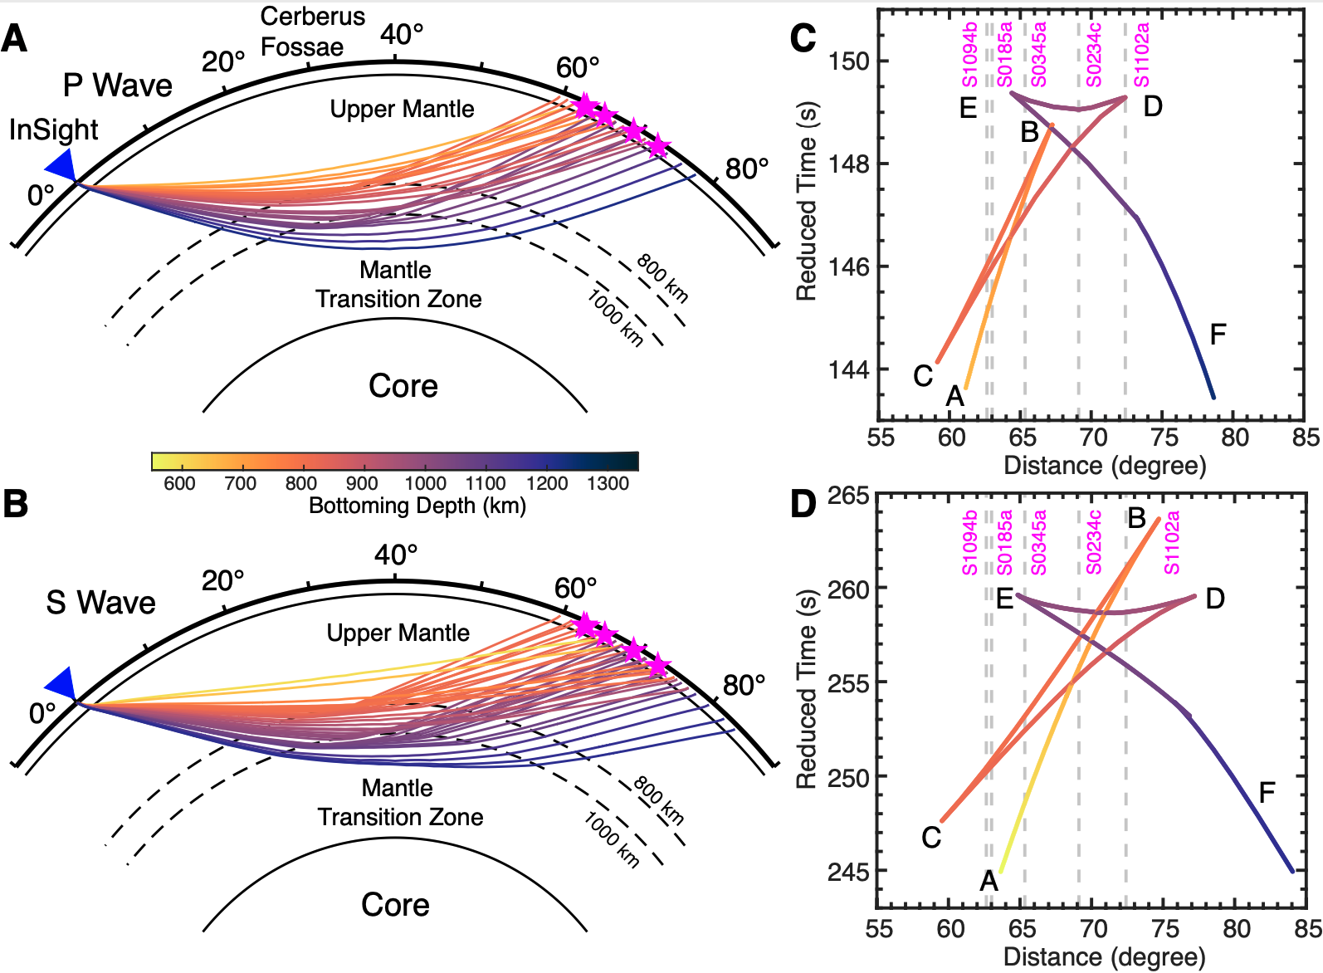
Body wave triplications
Huang et al. PNAS (2022)

Slide 43
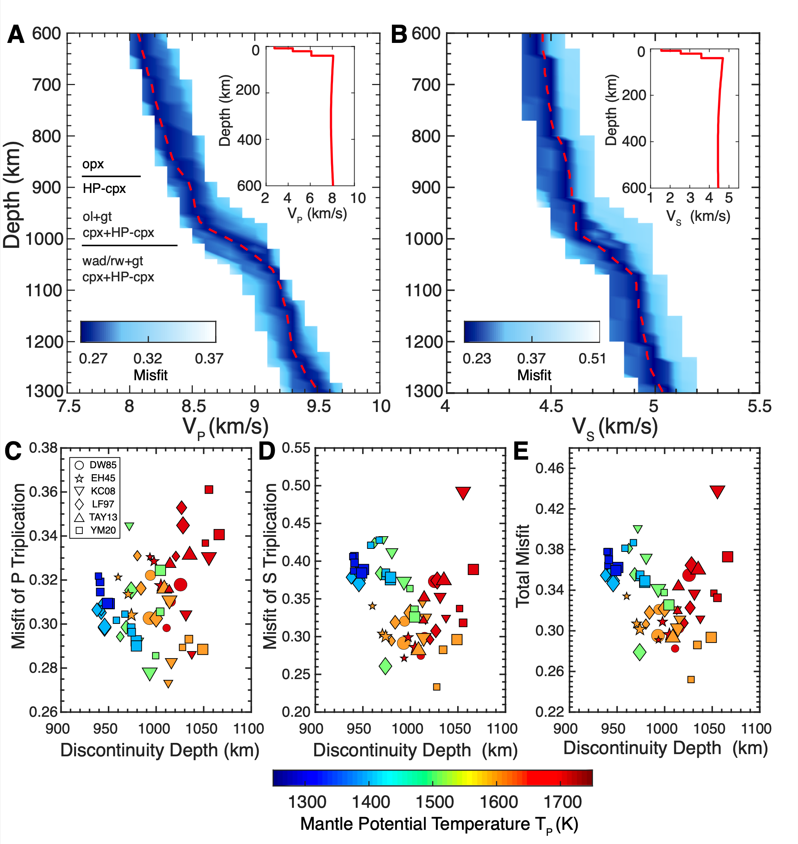
Olivine phase transition
Olivine-post olivine transition at 1006±40 km
Mantle potential temperature of 1605±100 K
Broad gradient, suggesting a Fe-enriched mantle
Huang et al. PNAS (2022)

Slide 44


ScS and the detection of the martian core
ScS phase emerged from stacked envelopes of 11 marsquakes
ScS phase is difficult to observe on individual seismograms- polarization filtering helps enhance the ScS arrival
ScS amplitudes imply a liquid metal core
Core radius is 1830 +/- 40 km
Stahler et al., 2022, Science

Slide 45

Martian core
The ratio of the core to the total planetary radius is similar to that of Earth (~0.47 on Mars, ~0.54 for Earth)
But the mean density of Mars is much lower!
This implies that the martian core is less dense than the Earths’. It must contain a significant proportion of light elements (e.g., sulfur).

Slide 46
Summary of discoveries by InSight
The scientific return from a single high-quality three-component seismometer on Mars has been astounding
Main discoveries about structure of Mars’ interior:
First-order structural constraints (Lognonne et al., 2020, Nat. Geosc.)
Crustal structure below lander (Knapmeyer-Endrun et al. 2021, Science; Kim et al. 2021, JGR)
First-order mantle velocity structure (Khan et al., 2021, Science; Drilleau et al. 2022, JGR)
Detection of core reflected waves (Stahler et al., 2021, Science)
Detection of core-transiting waves (Irving et al., accepted in PNAS)
Photographic + seismic detection of impacts (Posiolova et al. 2022, Science; Garcia et al. 2022, Nat. Geosc.)
Rayleigh wave detection, crustal structure away from lander (Kim et al. 2022, Science)
Mantle transition zone detection, via triplications (Huang et al. 2022, PNAS)
Detection of Love waves and surface wave overtones (Beghein et al., 2022 GRL, Kim et al., 2022 GRL)
Anisotropy (Vsh>Vsv) detection (Beghein et al., 2022 GRL, Kim et al., 2022 GRL)
Structure of north-south crustal dichotomy (Kim et al., 2022 GRL )
Marsquake source mechanisms (Brinkman et al., 2022 JGR, Sita & van der Lee 2022 JGR, Jacob et al. 2022 Tectonophysics, Maguire et al., (in review )

